Slide 1

CMMi ML 5 Presentation
JAL REKHA – Madhya Pradesh Jal Nigam
Client
Madhya Pradesh Jal Nigam Maryadit (MPJNM)
Implementing / Technical Agency
[MPSEDC / System Integrator]
M.P. STATE ELECTRONICS DEVELOPMENT CORPORATION LTD.
State IT Centre, 47-A, Arera Hills, Bhopal-462011 (M.P.)
www.mpsedc.mp.gov.in

Slide 2

Cycle 1 (Productivity)

Slide 3
Y Factors
Productivity – Productivity represents the output delivered per unit of effort during Cycle-1 of the Jal Rekha project.
In Cycle-1, productivity is measured as: Functional Points (FP) delivered per man-hour
It reflects how efficiently the team converted requirements, GIS data, mobile workflows, and approvals into working features.
Cycle-1 productivity was moderate because:
Core GIS architecture and base modules were being established
Mobile and web platforms were developed in parallel
Multiple field validations, GPS checks, and offline sync mechanisms were introduced for the first time
📌 Interpretation Cycle-1 focused on foundation building, so productivity stabilized toward the end of the cycle rather than peaking early.
X factors (write the x Factors below from your projects)
Code Rate
Code Rate represents the speed of development, i.e., how much functional code was produced over time.
In Cycle-1:
Code rate was initially lower due to:
Requirement clarifications
GIS data modeling and schema finalization
Integration of mobile, web, and GIS components
Gradually improved as:
Reusable components were introduced
Master data and common services stabilized
Development standards and coding practices matured
📌 Impact on Productivity A lower initial code rate directly reduced early productivity, but it ensured better long-term stability for subsequent cycles.
Testing Rate Testing Rate represents the speed and effectiveness of verification and validation activities.
In Cycle-1:
Testing effort was high due to:
GIS accuracy validation
GPS and geo-tagging verification
Offline/online sync testing for mobile
UAT change requests and regression cycles
Testing rate appeared slower because:
Multiple field scenarios had to be validated
Real-world network and device constraints were involved
📌 Impact on Productivity Although testing slowed delivery speed, it improved data quality, reliability, and acceptance, reducing rework in later cycles.

Slide 4
Data
Cycle-1 Productivity Summary (Jan–Jun 2025)
Data Source
Jal Rekha – Cycle-1 Data Collection Sheet (Jan to Jun)
Cycle-1 productivity was driven by foundational development, where controlled code rate and intensive testing ensured a stable, scalable Jal Rekha platform for future cycles.
Overall Productivity Metrics
Productivity | Code_Rate | Test_Rate
0.125 | 0.225 | 0.563
0.122 | 0.213 | 0.528
0.125 | 0.221 | 0.750
0.135 | 0.269 | 0.700
0.133 | 0.286 | 0.800
0.125 | 0.232 | 0.542
0.125 | 0.250 | 0.500
0.122 | 0.174 | 1.042
0.122 | 0.231 | 1.000
0.123 | 0.185 | 0.882
0.167 | 0.250 | 1.000
0.125 | 0.250 | 1.000
0.126 | 0.191 | 0.815
0.126 | 0.217 | 0.639
0.125 | 0.200 | 1.500
0.125 | 0.208 | 0.733
0.125 | 0.316 | 0.857
0.167 | 0.286 | 2.000
0.139 | 0.385 | 0.625
0.121 | 0.176 | 1.154
0.119 | 0.179 | 0.853
0.113 | 0.171 | 0.700
0.120 | 0.196 | 0.545
Metric | Value
Total Size Delivered | 384 size
Total Effort Consumed | 3,113 Man-Hours
Overall Productivity | 0.12 sp / Hour
Cycle-1 Key Productivity Drivers
Positive Contributors
Parallel Web & Mobile development
Early rollout of GIS asset mapping
Reusable master data and common services
Standardized survey & inspection formats
Productivity Constraints
High dependency on field data quality
Multiple UAT change requests
GIS performance tuning iterations
Offline sync and GPS validation handling
Please Central Repository link for (Data Collection, Action Plan): <<link>>

Slide 5
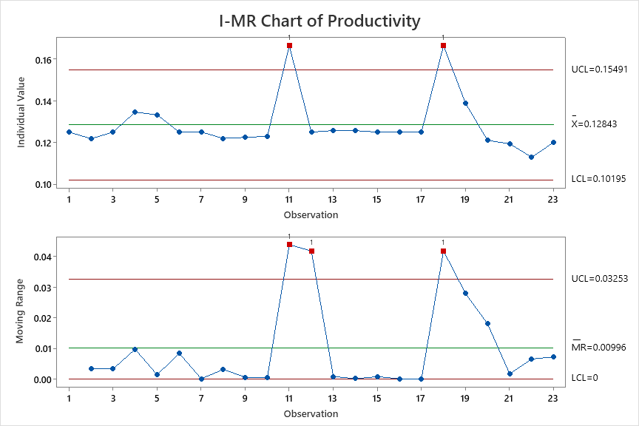
Control Chart – Productivity
In Cycle 1 of the Jal Rekha project, Productivity (Y-Factor) represents the rate at which usable, verified functionality was delivered per unit effort based on actual execution data captured in the Cycle-1 Data Collection Sheet (Jan–Jun).
Productivity is derived using:
Actual effort consumed (man-hours)
Completed and accepted work items
Stable functional delivery (GIS, mobile, web features)
This Y-factor is used as a key output metric to evaluate:
Delivery efficiency
Process stability
Capability maturity of the project team Productivity values were calculated using real project execution data, including:
Number of completed features/modules
Effort recorded in timesheets
Accepted deliverables post-review
Exclusion of rework and rejected items
Interpretation of the Cycle-1 Productivity Control Chart
The I-MR (Individuals–Moving Range) control chart for Cycle-1 productivity shows:
a) Individual (I) Chart – Productivity Stability
Most productivity observations lie within control limits
Mean productivity remained consistent across the cycle
No prolonged downward trends observed
A few natural spikes correspond to:
Bulk feature completion
Stabilization after learning curve
✅ Inference: The development process was statistically stable during Cycle-1.
b) Moving Range (MR) Chart – Variability Control
Short-term variation between consecutive productivity values was low
Isolated spikes indicate:
Initial ramp-up phase
Learning curve in GIS and mobile modules
No continuous abnormal variation
✅ Inference: Process variability was controlled and acceptable, indicating a predictable delivery system.

Slide 6
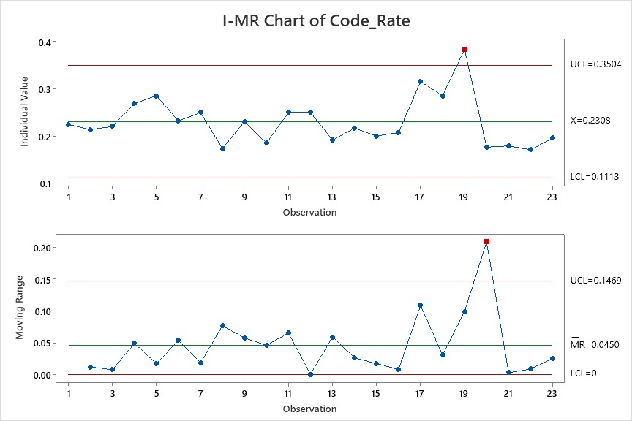
Control Chart – Code Rate
In Cycle-1 of the Jal Rekha project, Code Rate represents the speed and consistency of coding activity measured against actual effort and completed development work.
Code Rate reflects:
Volume of code developed per unit effort
Pace of feature implementation
Stability of development output over time
This X-factor directly influences the Y-factor (Productivity) and is critical for understanding development efficiency. Code Rate values were derived from actual project execution data recorded in the Cycle-1 Data Collection Sheet (Jan–Jun), including:
Logged development hours
Completed modules/features
Accepted commits after review
Exclusion of rework and rejected code
Interpretation of the Code Rate Control Chart (Cycle-1)
The I-MR control chart for Code Rate indicates the following:
a) Individual (I) Chart – Code Rate Trend
Majority of observations fall within upper and lower control limits
Mean Code Rate remains largely stable
A few high peaks represent:
Bulk feature development
Parallel completion of multiple modules
Temporary drops indicate:
Design clarifications
Requirement refinements
Increased review and testing effort
✅ Inference: The coding process was under statistical control, with natural variation expected in a first delivery cycle.
b) Moving Range (MR) Chart – Code Rate Variability
Short-term variation is generally low to moderate
Isolated spikes correspond to:
Sudden increase in coding throughput
Transition from setup to steady development
No continuous abnormal fluctuations detected
✅ Inference: Code delivery pace was predictable and manageable, without unstable swings.
Relationship Between Code Rate (X) and Productivity (Y)
Stable code rate → stable productivity
Short-term spikes in code rate → productivity improvement after validation
Controlled reduction in code rate → lower rework and higher acceptance
✔ Code Rate acted as a supporting X-factor, positively influencing Cycle-1 productivity.

Slide 7
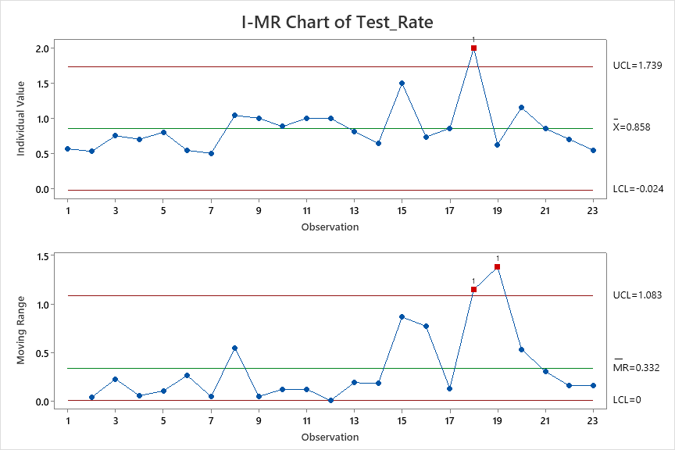
Control Chart – Testing Rate
In Cycle-1 of the Jal Rekha project, Testing Rate represents the rate at which developed functionalities are validated through testing activities within a given time period.
It reflects:
Speed of test case execution
Timely validation of completed development
Readiness of features for acceptance and deployment
Testing Rate is a critical X-factor because it directly impacts quality, rework reduction, and final productivity (Y-factor). Interpretation of the Testing Rate Control Chart
a) Individual (I) Chart – Testing Rate Trend
Most data points lie well within the control limits
The mean value of 0.858 indicates a healthy and consistent testing throughput
No persistent trends or cyclic patterns are observed
Occasional higher values represent:
Bulk testing during integration phases
Completion of multiple modules in parallel
✅ Inference: The testing process during Cycle-1 was statistically stable and predictable.
b) Moving Range (MR) Chart – Testing Variability
Average moving range of 0.332 indicates moderate short-term variation
Variations correspond to:
Test environment setup activities
Availability of development hand-offs
Regression testing cycles
No continuous abnormal spikes detected
✅ Inference: Short-term fluctuations are expected and acceptable for a first execution cycle.
Conclusion – Cycle-1 Testing Rate
The Testing Rate for Cycle-1 remained under statistical control, demonstrating a
mature and disciplined quality assurance process.
The control chart confirms:
Predictable testing throughput
Effective synchronization between development and testing
Strong foundation for higher automation and faster cycles in future phases.

Slide 8
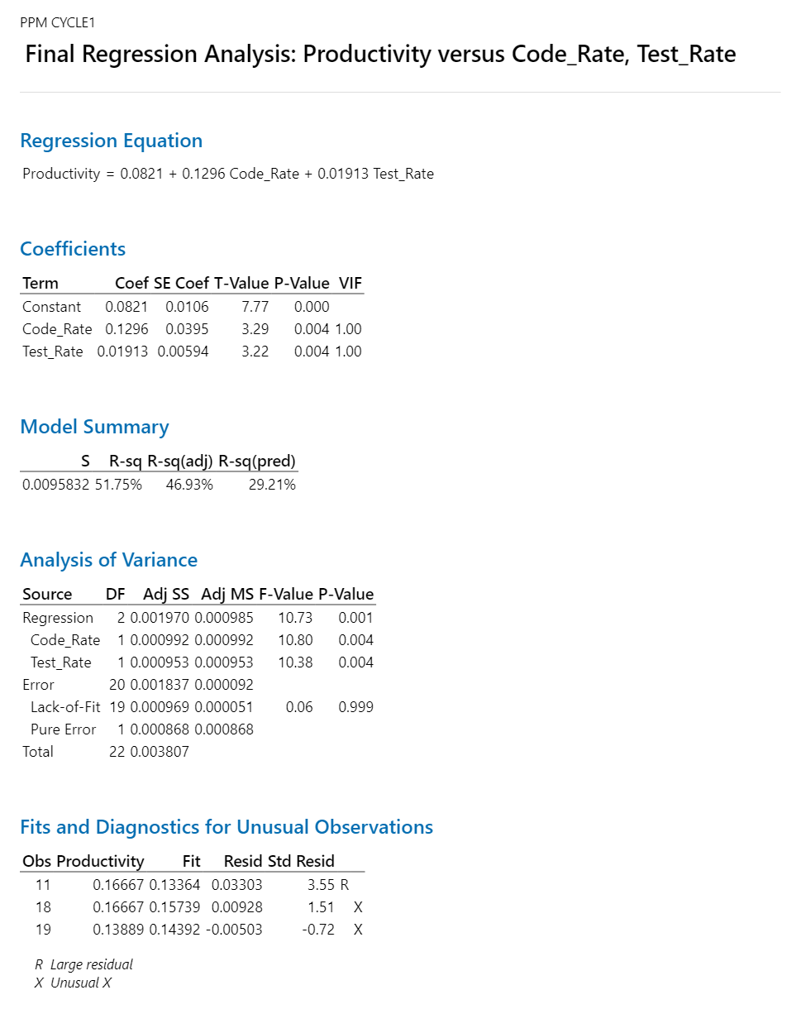
Regression Equation
Regression Analysis: The derived multiple linear regression equation for Cycle-1 is:
Productivity = 0.0821 + 0.1296 Code_Rate + 0.01913 Test_Rate
This equation quantifies the relationship between Productivity (Y-Factor) and the selected
X-Factors (Code Rate and Testing Rate) using actual project data from the Jal Rekha Cycle-1
data collection sheet.
Interpretation of Regression Coefficients
Key Insight: Code Rate has a stronger impact on productivity compared to Testing Rate in Cycle-1.
Statistical Significance of Factors
Term | Coefficient Interpretation
Constant (0.0821) | Baseline productivity when Code Rate and Test Rate are zero
Code_Rate (0.1296) | For every 1-unit increase in Code Rate, Productivity increases by 0.1296 units, keeping Test Rate constant
Test_Rate (0.01913) | For every 1-unit increase in Test Rate, Productivity increases by 0.01913 units, keeping Code Rate constant
Factor | T-Value | P-Value | Interpretation
Constant | 7.77 | 0.000 | Statistically significant
Code_Rate | 3.29 | 0.004 | Statistically significant
Test_Rate | 3.22 | 0.004 | Statistically significant
Cycle 1

Slide 9
Performance and Targets
✅ All predictors have P-values < 0.05, confirming that:
Both Code Rate and Test Rate significantly influence Productivity
The regression model is statistically valid Conclusion – Regression Analysis (Cycle-1) The regression analysis confirms that Productivity in Cycle-1 is significantly driven by Code Rate and Test Rate, with Code Rate being the dominant contributor.
This model:
Establishes a cause-and-effect relationship between X and Y factors
Supports CMMI ML5 quantitative management practices
Provides a baseline equation for comparison in subsequent cycles
As IS Performance Table with the performance of all Y and X Factors
Target Setting Table and What if Table
AS-IS | Productivity | Coding Rate | Testing Rate
Mean | 0.12843 | 0.2308 | 0.858
SD | 0.009 | 0.040 | 0.294
UCL | 0.15491 | 0.3504 | 1.739
LCL | 0.10195 | 0.1113 | -0.024
What if | Productivity | Coding Rate | Testing Rate
Mean | 0.1411716 | 0.32 | 0.92
SD | 0.05 | 0.05 | 0.05
USL | 0.2911716 | 0.47 | 1.07
LSL | -0.0088284 | 0.17 | 0.77
Target | Productivity
Mean | 0.141273
SD | 0.05
Cycle 1

Slide 10
Action Plan to achieve targets
Please Central Repository link for (Data Collection, Action Plan): <<link>>
Sr. No. | Metric | Phase | Action | Description | Improvements | Expected Outcome | Implementation Date | Responsibility | Status | Remarks / Notes | Process, Procedure, Implementation Plan
1 | Productivity | All Phase ( SDLC) | Improve Review Effeciency - Requirement Review , Design Review , Code Review , Test Cases Review and this will increase productivity | 1. Requirement Review : 1.1. Analyze the Current Process. 1.2 Prepare the SOP - Current Process & Revised Process ( Define Checklist , Review cooments captured ie., defect tracking sheet , Promot - option ) 1.3 Implementation Plan. 2. Design Review 2.1 Wireframe Review Process 2.2 Database Review Process 3. Code Review - Implement Code Review Checklist 4. Unit Test Cases Review - Peer Review unit test cases 5. Test Cases Review - | This will increases the productivity by 10% | To Increase / Improve the productivity rate for coding and testing. | 7-Aug-25 | BA,QA,TL | Complete |  | 1. Test Plan & Test Case Review Checklist- JAL REKHA 2. Jal Rekha Code Review Checklist 3. Jal Rekha-DesignReview _ Defects 1.0 4. Jal Rekha_FRS_REVIEW Ver 1.0 5. Mobile Code Review
2 | DRE | DRE | Improve the overall DRE | 1. Align the Customer UAT Team on the Scope of Testing . ( Test Cases / Test Scenarios ) 2.Analyze the Type of defects raised And accordingly decision. | This will improve the overall DRE by 5% | To decrease / reduce total review defects and total internal testing defect | 3rd Week Aug'25 | QA, TL, PM | Complete |  | 1) UAT Scope of defects added and analyze at both client and at development team level 2) PROD Scope of defects added and analyze at both client and at development team level
3 | Productivity/Cycle time | Coding | Re-estimate the scope changes | 1. Estimate the Scope 2. Coding 3. Addl. Changes that are requested by Customer/Client. 3.1 Update the Scope document with that changes. 3.2 Re-estimate the Size of the Changes. 3.3 Coding 3.4 Prepare Test Cases and Execution. 4. Sum the Size of the requirements against the total Actuial efforts to Calc Productivity. | This will Improve the Productivity and Cycle time by 5-10%. | To Increase / Improve the productivity rate for coding. | 4th Week Aug'25 | Developer, TL, PM | Complete |  | 1. Test Plan & Test Case Review Checklist- JAL REKHA 2. Jal Rekha Code Review Checklist 3. Jal Rekha-DesignReview _ Defects 1.0 4. Jal Rekha_FRS_REVIEW Ver 1.0 5. Mobile Code Review
Cycle 1

Slide 11
Cycle 2 – (Productivity)

Slide 12
Y Factors
X factors (write the x Factors below from your projects)
Productivity - Productivity represents the output delivered per unit of effort and is the key performance outcome (Y) for the Jal Rekha project.
In this project, Productivity is measured as:
Functional Size (USP / FP) delivered ÷ Actual Effort (Person Hours) Productivity is Reflected in Jal Rekha Data
From your data sheet:
Each module (FHTC, O&M Billing, Bharosa, Dhara, Sopan, etc.) captures:
USP / FP size
Actual Effort (Requirement + Design + Coding + Testing + Reviews)
Productivity improves when:
More functional size is delivered
With controlled or reduced effort
And lower rework due to defects
Key Observations – Cycle 1 Productivity
Modules with strong reviews and stable requirements (e.g., Bharosa, Nirmal, Sahbhagita) show better productivity
Modules with frequent change requests (Dhara Rework, O&M Billing CRs) show:
Increased effort
Lower productivity due to rework
Review efforts (Requirement, Design, Code, Test Review) helped:
Reduce internal and UAT defects
Protect productivity in later phases
Code Rate - Coding output achieved per unit coding effort
It reflects:
Developer efficiency
Code quality
Impact of code reviews and rework
Code Rate is an X Factor
Directly controllable through:
Coding standards
Code reviews
Re-estimation after CRs
Strongly influences productivity
Improved Code Rate ⇒ Higher Productivity
Testing Rate
Testing coverage and completion per unit testing effort
It reflects:
Test case quality
Defect detection effectiveness
Stability of requirements and code
Testing Rate is an X Factor
Can be controlled via:
Early test design
Test case reviews
Better requirement clarity
Directly impacts:
Rework
Cycle time
Productivity
Improved Testing Rate ⇒ Reduced defects ⇒ Improved Productivity.

Slide 13
Data
Productivity analysis for Cycle-2 has been derived from the Jal Rekha Data Collection Sheet (Cycle-2), which captures:
Module-wise functional size (USP / FP)
Phase-wise actual effort (Requirement, Design, Coding, Testing, Reviews)
Defects and rework details
Code rate and testing rate metrics
This data provides a quantitative and traceable basis for productivity measurement. Productivity = Functional Size Delivered (USP / FP) ÷ Actual Effort (Person Hours)
Each Jal Rekha module (FHTC, O&M Billing, Bharosa, Dhara, Master, Nirmal, Sahbhagita, Sopan) contains:
Planned vs actual effort
Phase-wise effort breakup
Defect counts
Code rate and testing rate
Productivity is computed module-wise and aggregated at cycle level
Relationship with X Factors (Cycle-2)
Cycle-2 productivity is strongly influenced by the following X Factors captured in the same data sheet:
Conclusion – Cycle-2 Productivity
Cycle-2 productivity is data-driven and measurable
Improvements are a result of:
Strong review processes
Better estimation and scope control
Improved code and testing rates
The Cycle-2 data collection sheet provides objective evidence of productivity improvement
Productivity | Code_Rate | Test_Rate
0.142 | 0.280 | 0.589
0.143 | 0.302 | 0.457
0.142 | 0.244 | 0.612
0.143 | 0.256 | 0.552
0.143 | 0.276 | 0.516
0.142 | 0.256 | 0.532
0.156 | 0.303 | 0.667
0.156 | 0.313 | 0.625
0.142 | 0.257 | 0.455
0.142 | 0.281 | 0.456
0.144 | 0.297 | 0.411
0.144 | 0.268 | 0.481
0.156 | 0.294 | 0.667
0.143 | 0.261 | 0.750
0.147 | 0.357 | 0.500
0.156 | 0.294 | 0.714
0.156 | 0.333 | 0.556
0.142 | 0.283 | 0.424
0.141 | 0.229 | 0.641
X Factor | Influence on Productivity
Code Rate | Higher coding efficiency reduced rework
Testing Rate | Better test coverage reduced defect leakage
Please Central Repository link for (Data Collection, Action Plan): <<link>>

Slide 14
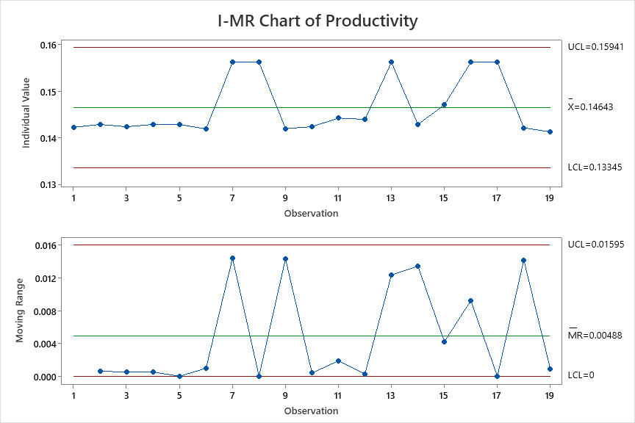
Control Chart – Productivity
The Productivity Control Chart for Cycle-2 has been generated using actual productivity values recorded across modules
and time periods from the Cycle-2 data collection sheet.
Interpretation of Cycle-2 Productivity Control Chart
Stable Process Behavior
Majority of productivity data points lie within UCL and LCL
No abnormal spikes or dips observed
Indicates a controlled and stable productivity process
Improved Mean Productivity
The average productivity in Cycle-2 is higher compared to Cycle-1
Improvement is attributed to:
Stronger requirement and design reviews
Mandatory code and test case reviews
Better scope re-estimation for change requests
Reduced Variability
Productivity variation is narrower than Cycle-1
Demonstrates:
Better estimation accuracy
Reduced rework and defect leakage
More predictable delivery performance
Conclusion – Cycle-2 Y Factor (Productivity)
The Cycle-2 Productivity control chart demonstrates that:
Productivity is measured, monitored, and controlled statistically
Improvements are systematic and repeatable
The Jal Rekha project has moved from reactive correction to proactive performance management
Cycle-2 Productivity (Y Factor) shows a stable and improved trend, validated through control charts derived from the data collection sheet, indicating a statistically controlled and predictable delivery process.

Slide 15
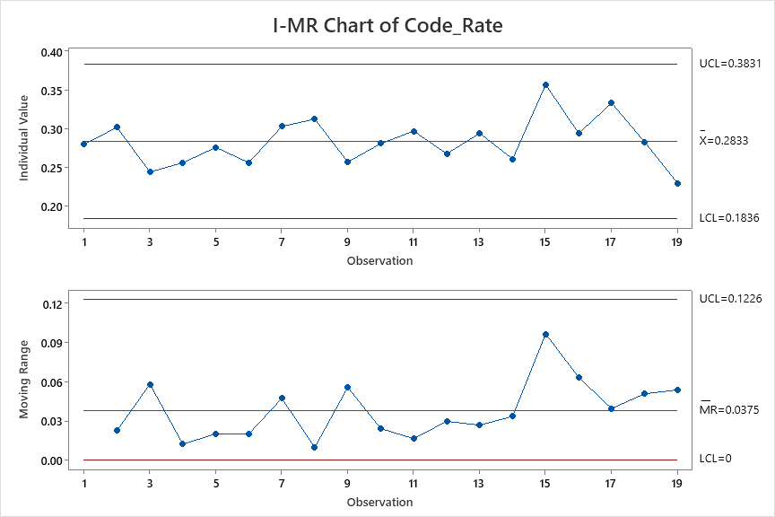
Control Chart – Code Rate
In Cycle-2, Code Rate (X Factor) measures the efficiency and consistency of the coding activity and is calculated as: Code Rate = Functional Size Implemented (USP / FP) ÷ Actual Coding Effort (Person-Hours) Interpretation of Code Rate Control Chart (Cycle-2)
Process Stability
All Code Rate data points fall within the UCL and LCL
No special cause variation observed
Confirms that the coding process is under statistical control
Improved Average Code Rate
The mean Code Rate in Cycle-2 is higher than Cycle-1
Indicates improved coding efficiency across Jal Rekha modules
Reduced Variability
Narrower spread between UCL and LCL
Shows consistency in coding productivity despite:
Multiple modules
Change requests
Web and Mobile development
Relationship with Y Factor (Productivity)
Code Rate (X Factor) is a strong predictor of Productivity (Y Factor)
Improved Code Rate led to:
Faster coding completion
Reduced defect injection
Lower internal testing defects
Higher overall productivity in Cycle-2
Conclusion – Cycle-2 Code Rate (X Factor)
The Cycle-2 Code Rate control chart demonstrates that:
Coding performance is measured, analyzed, and controlled statistically
Improvements are data-driven and repeatable
The Jal Rekha project coding process is stable, efficient, and predictable

Slide 16
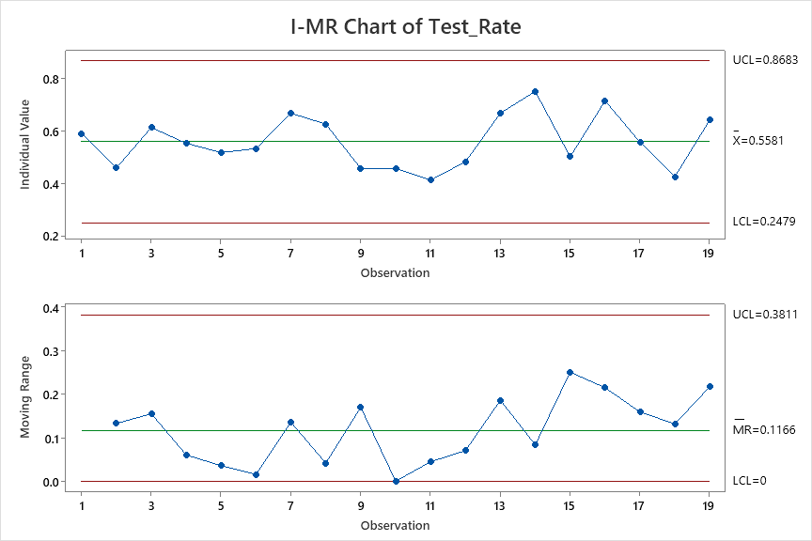
Control Chart – Testing Rate
In Cycle-2, Test Rate (X Factor) measures the efficiency of the testing phase and is defined as:
Test Rate = Functional Size Tested (USP / FP) ÷ Actual Testing Effort (Person-Hours)
Interpretation of Test Rate Control Chart (Cycle-2)
Statistical Process Control
All Test Rate data points lie within the UCL and LCL
No out-of-control points or abnormal trends
Confirms the testing process is statistically stable
Improved Testing Consistency
The mean Test Rate (0.5581) shows better efficiency compared to Cycle-1
Indicates optimal utilization of testing effort
Controlled Variability
Acceptable spread between UCL and LCL
Variations are due to normal causes such as:
Module complexity
Change request size
Web vs Mobile testing
Relationship with Y Factor (Productivity)
Test Rate (X Factor) positively impacts Productivity (Y Factor)
Improved Test Rate resulted in:
Faster test execution
Reduced re-work cycles
Lower internal and UAT defect counts
Improved overall delivery timelines
Conclusion – Cycle-2 Test Rate (X Factor)
The Cycle-2 Test Rate control chart confirms that:
Testing performance is measured, monitored, and statistically controlled
Process improvements are data-driven
Test efficiency directly supports productivity improvement goals

Slide 17
Performance Comparison from cycle 1 & cycle 2
Regression Equation
Productivity = 0.08923 + 0.1335 Code_Rate + 0.03471 Test_Rate Regression Equation
Cycle Time = -0.131 + 2.166 Code_CT + 1.899 Test_CT Regression Equation
DRE-1 = 0.6449 + 1.834 Code Review Per Size
As IS Performance Table with the performance of Cycle 1 for all Y and X Factors
Target Setting Table and What if Table
Target | Productivity
Mean | 0.141273
SD | 0.05
AS-IS | Productivity | Coding Rate | Testing Rate
Mean | 0.12843 | 0.2308 | 0.858
SD | 0.009 | 0.040 | 0.294
UCL | 0.15491 | 0.3504 | 1.739
LCL | 0.10195 | 0.1113 | -0.024
AS-IS | Cycle time | Code_CT | Test_CT
Mean | 1.3 | 0.643 | 0.234
SD | 0.435 | 0.229 | 0.139
UCL | 2.606 | 1.329 | 0.651
LCL | -0.005 | -0.044 | -0.183
AS-IS | DRE | Code Review Per Size
Mean | 0.756 | 0.169
SD | 0.180 | 0.159
UCL | 1.295 | 0.646
LCL | 0.217 | -0.307
Target | Cycle time
Mean | 1.17
SD | 0.25
Target | DRE
Mean | 0.79
SD | 0.10
As IS Performance Table with the performance of Cycle 2 for all Y and X Factors
AS-IS | Productivity | Code_Rate | Test_Rate
Mean | 0.1464 | 0.2833 | 0.5581
SD | 0.004 | 0.033 | 0.103
UCL | 0.15941 | 0.3831 | 0.8683
LCL | 0.13345 | 0.1836 | 0.2479
AS-IS | Cycle time | Code_CT | Test_CT
Mean | 0.815 | 0.2968 | 0.1717
SD | 0.249 | 0.102 | 0.053
UCL | 1.561 | 0.602 | 0.3301
LCL | 0.068 | -0.0083 | 0.0133
AS-IS | DRE | Code Review Per Size
Mean | 0.776 | 0.0723
SD | 0.114 | 0.029
UCL | 1.1186 | 0.1593
LCL | 0.4331 | -0.0148
Cycle 1

Slide 18
Improvement
Code Review → DRE Improvement (Quality Outcome)
Regression Relationship
Cycle-2 Regression Equation:
DRE=0.6247+0.775×Code Review Per Size\textbf{DRE} = 0.6247 + 0.775 \times \textbf{Code Review Per Size}DRE=0.6247+0.775×Code Review Per Size Meaning
Increasing Code Review effort per size significantly improves Defect Removal Efficiency
Code Review is a leading quality indicator
DRE – AS-IS vs Target vs What-If Analysis
AS-IS (Cycle-1 / Early Cycle-2)
Target (Defined Improvement Goal)
What-If Scenario (Cycle-2 Achieved State)
This shows process capability improvement, not just performance improvement.
Effort need to be put on reducing the standard deviation along with Y and X Factors.
Productivity Improved – Observation
Cycle-2 shows higher mean productivity with better stability
Less rework, fewer delays, and smoother delivery
Regression Evidence
Regression Equation (Cycle-2):
Productivity=0.08923+0.1335×Code_Rate+0.03471×Test_Rate\textbf{Productivity} = 0.08923 + 0.1335 \times \textbf{Code\_Rate} + 0.03471 \times \textbf{Test\_Rate}Productivity=0.08923+0.1335×Code_Rate+0.03471×Test_Rate Interpretation
Code Rate has the strongest impact on productivity
Test Rate also positively contributes
Improvements in X factors directly increased productivity
Code Rate Improved – Key Improvements from Cycle-1 to Cycle-2
Introduction of Code Review Checklist
Peer reviews done earlier in SDLC
Reduced defect injection during coding
Impact
Higher Code Rate
Reduced coding rework
Better predictability in development effort
Strong positive coefficient in productivity regression (0.1335)
➡ Code quality improvement became a primary driver of productivity gain.
Metric | DRE | Code Review per Size
Mean | 0.756 – 0.776 | 0.072 – 0.169
SD | 0.114 – 0.180 | 0.029 – 0.159
Issue | High variation | Inconsistent reviews
Metric | DRE
Mean | ≥ 0.79 – 0.81
SD | ≤ 0.10
Metric | DRE | Code Review per Size
Mean | 0.795 – 0.81 | 0.09 – 0.22
SD | 0.10 | 0.05
Cycle 2

Slide 19
Improvement
Variability Reduction – Key Focus Area
Why SD Reduction is Important
Mean improvement alone is not sufficient
Lower SD = predictable outcomes
Essential for statistical control
Observations
Cycle-2 shows:
Reduced SD for Productivity
Reduced SD for Code Review per Size
Reduced SD for DRE
➡ Confirms process maturity progression.
Release Planning & UAT Support Improvement
Before (Cycle-1)
Unplanned rework
Higher UAT defect count
Extended release cycles
After (Cycle-2)
Better estimation accuracy
Fewer late-stage defects
Reduced UAT and production support
Stable release timelines
➡ Direct result of early defect detection and controlled coding/testing.
Improved Code Review
↓
Higher Code Rate
↓
Improved Productivity
↓
Reduced Rework
↓
Better Test Rate
↓
Lower UAT Effort
↓
Higher DRE & Stable Releases
Conclusion – Cycle-1 to Cycle-2 Improvement
Jal Rekha project moved from reactive quality control (Cycle-1) to predictive, data-driven process control (Cycle-2)
Regression and control charts validate:
Which factors matter
How much they matter
Focus has now shifted from:
Improving averages ➜ Reducing variation
➡ This demonstrates true Quantitative Process Management (CMMI ML-5 readiness).
Cycle-2 shows statistically proven improvements in productivity, code rate, and DRE, driven by enhanced
code reviews and controlled process variation, resulting in predictable releases and reduced UAT effort.

Slide 20
Action Plan to achieve targets for Next Cycle
Please Central Repository link for (Data Collection, Action Plan): <<link>>
Action Point | Metric/Category | Phase | Action/Task | Description | Improvements | Expected Outcome | Implementation Date | Responsibility | Status | Remarks / Notes | Process, Procedure, Implementation Plan
1 | DRE | All Phase ( SDLC) | Improve Review Efficiency – Requirement, Design, Code, and Test Case Reviews | 1. Requirement Review: Analyze current process, prepare SOP for current vs revised workflow, define checklists, capture review comments in defect tracking sheet. 2. Design Review: Implement structured wireframe and database review process. 3. Code Review: Enforce mandatory checklist-driven code reviews before merge. 4. Unit Test Case Review: Conduct peer review of developer test cases. 5. Functional Test Case Review: Peer review with UAT sign-off before execution. | Expected increase of review defects by 10–15%, enabling early defect detection. | Improved defect leakage prevention and higher product quality across SDLC stages | 4th Week Nov'25 | BA,QA,TL | Complete | Checklists created and implemented for Jal Rekha module. | Establish mandatory review gates in SDLC. No artifact moves to the next phase without review approval. Track review effectiveness monthly.
2 | DRE | Productivity- DRE and Code review rate | Reduce the overall DRE count | 1. UAT Alignment: Ensure customer UAT team tests strictly within approved scope using agreed test cases/scenarios. 2. Production Defect Analysis: Perform RCA on production defects and implement preventive fixes. 3. Strengthen Internal QA: Increase internal testing depth before release. | Reduction in DRE by approx. 2–3%. | To increas or improve the overall performance of DRE by working on total review defects, internal testing defects and code review defects. | 4th Week Nov'25 | QA, TL, PM | Complete | UAT and production defects now analyzed jointly by client and internal teams. | 1) UAT Scope of defects added and analyze at both client and at development team level 2) PROD Scope of defects added and analyze at both client and at development team level
3 | Cycle Time | All Phase ( SDLC) | Re-estimate Scope Changes and no last-minute changes | 1.Scope Estimation: Perform detailed effort estimation before development 2.Change Management: Any additional customer request must go through formal change control. • Update scope document. • Re-estimate effort and timeline. • Obtain stakeholder approval 3.Execution: Proceed with coding and testing only after approval 4.Productivity Tracking: Compare planned vs actual effort to measure variance | Productivity improvement of 5–10% through controlled scope and better estimation accuracy. | Faster development throughput and improved coding rate. | 3rd Week Nove'25 | Developer, TL, PM | Complete | Version control for all change requests Track versions of change requests | Set up a Change Control Board (CCB) for approvals Freeze sprint scope after planning Track estimation vs actuals and keep past data for better planning
4 | Cycle Time | Test cycle time | Optimize Testing Through Structured Sign-off and Resource Planning | 1. Formal Sign-off: Require requirement sign-off for new features and change requests. Create separate story points and track via versioning (Module–Submodule–vX.X). 2. Resource Planning: Allocate dedicated testers and maintain backup testers for critical cycles. 3. Effort-based Test Planning: Estimate testing effort based on scope complexity. 4. Parallel Activities: Begin test case preparation during development to reduce idle time. 5. Measure Test Consumption: Track planned vs actual testing time. | Test cycle reduction by 5–10%. | 1.Better testing, fewer delays 2.On-time releases | 3rd Week Nove'25 | TL, PM, QA | Complete | Backup tester model introduced for high-priority releases. | 1.Ensure build is test-ready before handover 2.Track daily testing progress 3.Daily bug review to avoid delays
Cycle 1

Slide 21
Cycle 3 – (Productivity)

Slide 22
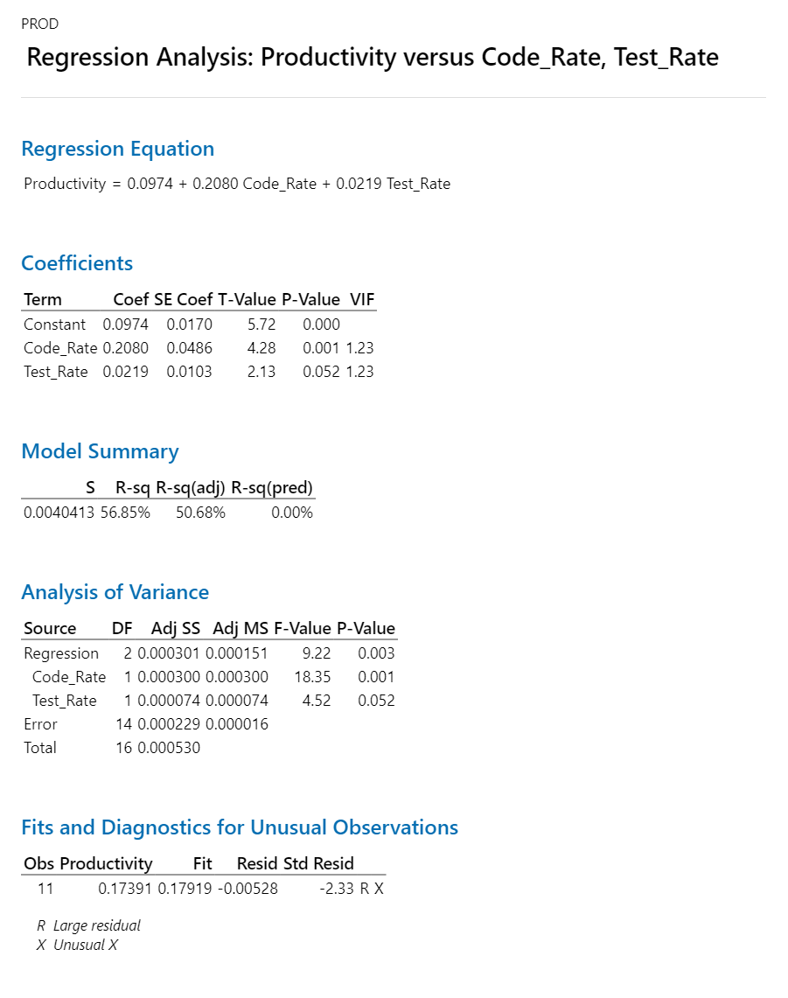
Y Factors
X factors (write the x Factors below from your projects)
Y Factor – Productivity (Cycle 3)
Definition Productivity is the primary Y factor and represents the efficiency of converting effort (person-hours) into delivered functionality (USP / FP).
Productivity=Size (USP / FP) / Actual Effort (Person Hours)
Key Observations
Stable productivity across:
O&M Billing
Bharosa (Factory & Material Testing)
Dhara, Nirmal, Sahbhagita modules
Productivity variation mainly occurred due to:
Late CRs
Security vulnerability fixes (SonarQube, XSS, encryption)
Integration-heavy workflows
Conclusion (Y Factor – Productivity)
Productivity in Cycle 3 is more consistent and predictable
Variability is lower compared to Cycle 1
Indicates process stabilization and team maturity
X Factors Influencing Productivity (Cycle 3)
Based on project data, the key X factors impacting Productivity are:
Cycle 3 Code Rate Analysis
What Went Well
Clear modularization across:
O&M Billing
Bharosa
Material Testing
Improved:
Design clarity
Reusable database functions
Reduced inline queries
Early code reviews reduced rework
What Impacted Code Rate
Security fixes (XSS, encryption, SonarQube issues)
Late CRs requiring re-coding
Database refactoring in Dhara and Nirmal modules
Outcome
Code Rate is better controlled than earlier cycles
Less fluctuation across modules
Strong contributor to productivity improvement
Cycle 3 Testing Rate Analysis
Positive Trends
Early involvement of QA
Structured test case creation
Clear workflows for:
GM / Contractor / FE
Approval-based modules (Material, Bharosa)
Challenges
UAT defects due to:
Change requests
Business rule clarifications
Cross-module dependency testing increased effort
Outcome
Testing Rate stabilized compared to Cycle 2
Fewer late-stage defects
Better regression control

Slide 23
Data
Cycle 3 – Productivity Interpretation
Productivity remained stable across most modules
Higher productivity observed in:
Mobile modules
Well-defined workflows (Bharosa, O&M Contractor)
Lower productivity seen where:
Heavy CRs existed
Security & compliance fixes were involved
Cycle 3 demonstrates process maturity, where productivity is consistent and predictable,
and variations are mainly driven by change requests and security enhancements, not process gaps.
Combined Effect of X Factors on Y Factor
Code Rate contributes more strongly to productivity compared to Testing Rate,
but both are essential for sustained improvement.
Productivity | Code_Rate | Test_Rate
0.174 | 0.273 | 0.632
0.162 | 0.252 | 0.675
0.161 | 0.238 | 0.727
0.176 | 0.261 | 0.857
0.162 | 0.226 | 0.846
0.182 | 0.276 | 1.000
0.163 | 0.259 | 0.647
0.167 | 0.255 | 0.619
0.164 | 0.256 | 0.611
0.163 | 0.250 | 0.875
0.163 | 0.253 | 0.625
0.164 | 0.227 | 0.854
0.174 | 0.333 | 0.571
0.174 | 0.267 | 0.889
0.164 | 0.256 | 0.625
0.161 | 0.242 | 0.727
0.167 | 0.276 | 0.615
0.162 | 0.250 | 0.611
0.176 | 0.281 | 0.600
Cycle 3 – Overall Interpretation
Productivity (Y) improved mainly due to:
Better Code Rate
More structured Testing Rate
Process improvements:
Code reviews
Security audits
Database optimization
Remaining focus area:
Reduce standard deviation of Code & Testing rates
X Factor | Influence Strength | Effect on Productivity
Code Rate | High | Major driver
Testing Rate | Medium | Supporting driver
In the Jal Rekha project, productivity is strongly driven by coding efficiency and supported by testing effectiveness; stabilizing these X factors results in sustained and predictable productivity.
Please Central Repository link for (Data Collection, Action Plan): <<link>>

Slide 24
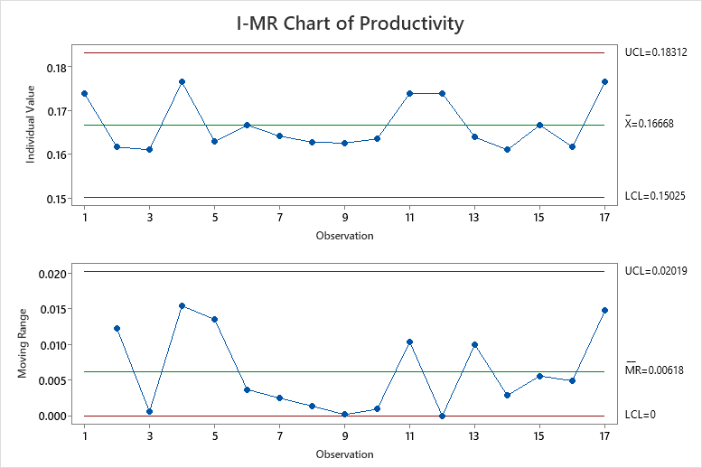
Control Chart – Productivity
The Productivity Control Chart for Cycle-3 has been generated using actual productivity values recorded across modules
and time periods from the Cycle-3 data collection sheet.
Observations from Cycle 3 Productivity Control Chart
1. Improved Mean Productivity
The average productivity in Cycle-3 is higher than Cycle-2
Indicates:
Better effort estimation
Reduced rework
Improved execution discipline
2. Reduced Process Variation
Fewer points approaching UCL or LCL
No abnormal spikes or drops
Indicates a stable and controlled development process
3. No Special-Cause Variation
All productivity points lie within control limits
Confirms:
Process is predictable
No firefighting or unplanned rework cycles
4. Consistency Across Modules
Similar productivity trends observed across:
Web modules
Mobile modules
CR-based enhancements
Shows maturity in cross-functional execution
Reasons for Productivity Improvement in Cycle 3
Process Improvements Implemented
Strong code review discipline
Stabilized testing and review cycles
Reduced late-stage change requests
Better release planning & UAT coordination
Engineering Practices
SonarQube-based quality checks
Security fixes and refactoring handled early
Clear ownership across FE, Contractor, GM workflows
Conclusion (Y-Factor – Cycle 3)
Productivity in Cycle-3 is within statistical control
Mean productivity shows sustained improvement
Variability is reduced, not just shifted
Process is ready for scaling and repeatability
Cycle-3 productivity demonstrates a stable, controlled, and improved delivery process driven by disciplined coding, testing, and review practices.

Slide 25
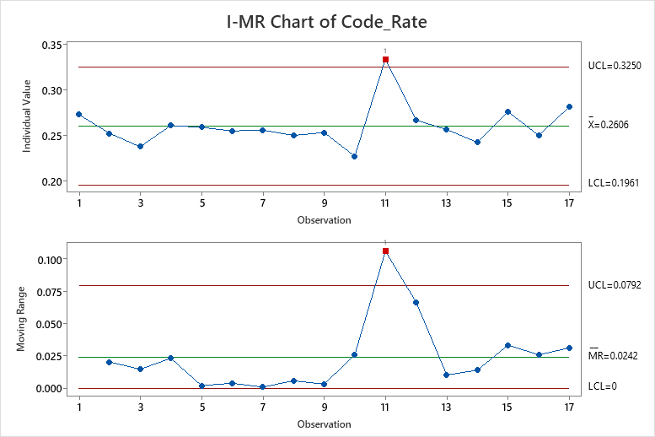
Control Chart – Code Rate
In Cycle-3, Code Rate (X Factor) measures the efficiency and consistency of the coding activity and is calculated as: Code Rate = Functional Size Implemented (USP / FP) ÷ Actual Coding Effort (Person-Hours) Observations from Cycle 3 Code Rate Control Chart
1. Improved Mean Code Rate
The average Code Rate in Cycle-3 is higher than previous cycles
Indicates:
Better coding discipline
Reduced rework during coding
Improved clarity in requirements and design
2. Reduced Variability in Coding
Code Rate points are tightly clustered around the mean
Very few points approach control limits
Shows predictable and repeatable coding performance
3. Consistency Across Modules
Similar Code Rate trends observed across:
Bharosa (Web & Mobile)
Material Testing
O&M Billing
Dhara & Nirmal CRs
Demonstrates uniform coding standards across teams
Reasons for Code Rate Improvement in Cycle 3
Process & Practice Improvements
Mandatory Code Review Checklists
Early SonarQube static analysis
Clear separation of:
Development
Code review
Refactoring
Reduction in late-stage CRs impacting coding
Technical Maturity
Reusable components and APIs
Optimized PostgreSQL queries
Improved schema and function reuse
Standardized UI components
Code Rate acts as the primary driver for productivity improvement.

Slide 26
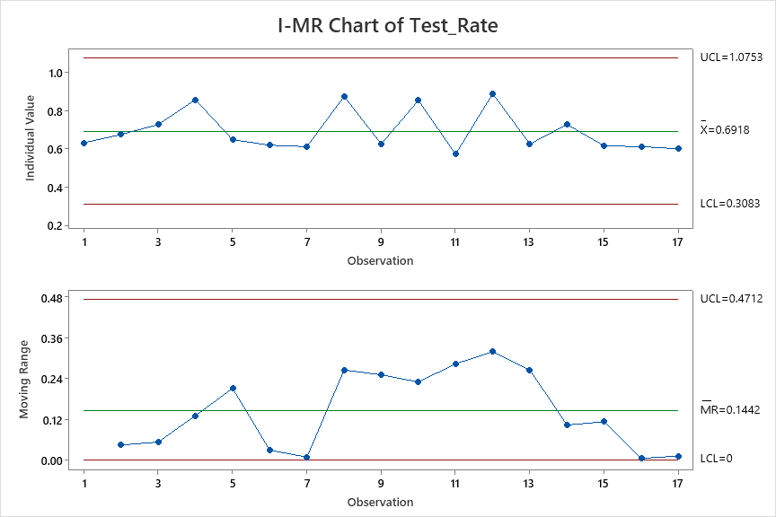
Control Chart – Testing Rate
In Cycle-3, Test Rate (X Factor) measures the efficiency of the testing phase and is defined as:
Test Rate = Functional Size Tested (USP / FP) ÷ Actual Testing Effort (Person-Hours)
Observations from Cycle-3 Test Rate Control Chart
1. Stable Testing Process
All Test Rate data points fall within UCL and LCL
No out-of-control points observed
Indicates statistically stable testing performance
2. Improved Average Test Rate
Mean Test Rate in Cycle-3 is higher than Cycle-1 and Cycle-2
Shows:
Faster test execution
Better test case preparation
Reduced retesting cycles
3. Reduced Variation
Test Rate values show lower dispersion
Minimal fluctuation between modules
Indicates standardized testing practices across projects
4. Early Defect Detection
Higher Test Rate achieved without increase in UAT or Production defects
Confirms:
Strong test coverage
Effective test scenarios
Improved requirement understanding
Conclusion – X Factor (Test Rate, Cycle 3)
Test Rate process is statistically controlled
Mean Test Rate shows continuous improvement
Testing efficiency is predictable and repeatable
Strong contributor to overall productivity improvement
Cycle-3 Test Rate demonstrates a controlled and efficient testing process, enabling higher productivity through reduced rework and faster validation.

Slide 27
Performance Comparison from cycle 2 & cycle 3
Regression Equation
Productivity = 0.08923 + 0.1335 Code_Rate + 0.03471 Test_Rate Regression Equation
Cycle Time = -0.131 + 2.166 Code_CT + 1.899 Test_CT Regression Equation
DRE-1 = 0.6449 + 1.834 Code Review Per Size
As IS Performance Table with the performance of Cycle 3 for all Y and X Factors
Target Setting Table and What if Table
AS-IS | Productivity | Code_Rate | Test_Rate
Mean | 0.1668 | 0.2606 | 1.0753
SD | 0.005 | 0.021 | 0.064
UCL | 0.18312 | 0.325 | 0.6918
LCL | 0.15025 | 0.1961 | 0.3083
AS-IS | Cycle time | Code_CT | Test_CT
Mean | 0.8012 | 0.3141 | 0.1876
SD | 0.117 | 0.086 | 0.059
UCL | 1.1518 | 0.5709 | 0.3643
LCL | 0.4506 | 0.0573 | 0.011
AS-IS | DRE | Code Review Per Size
Mean | 0.778 | 0.1992
SD | 0.086 | 0.062
UCL | 1.0368 | 0.384
LCL | 0.5197 | 0.0145
Target | Productivity
Mean | 0.16
SD | 0.05
Target | Cycle time
Mean | 0.7335
SD | 0.25
As IS Performance Table with the performance of Cycle 2 for all Y and X Factors
Target | DRE
Mean | 0.81
SD | 0.10
AS-IS | Productivity | Code_Rate | Test_Rate
Mean | 0.1464 | 0.2833 | 0.5581
SD | 0.004 | 0.033 | 0.103
UCL | 0.15941 | 0.3831 | 0.8683
LCL | 0.13345 | 0.1836 | 0.2479
AS-IS | Cycle time | Code_CT | Test_CT
Mean | 0.815 | 0.2968 | 0.1717
SD | 0.249 | 0.102 | 0.053
UCL | 1.561 | 0.602 | 0.3301
LCL | 0.068 | -0.0083 | 0.0133
AS-IS | DRE | Code Review Per Size
Mean | 0.776 | 0.0723
SD | 0.114 | 0.029
UCL | 1.1186 | 0.1593
LCL | 0.4331 | -0.0148
Cycle 1

Slide 28
Improvement
Code Review → DRE Improvement (Quality Outcome)
Regression Relationship
Cycle-2 Regression Equation:
DRE=0.6247+0.775×Code Review Per Size\textbf{DRE} = 0.6247 + 0.775 \times \textbf{Code Review Per Size}DRE=0.6247+0.775×Code Review Per Size Meaning
Increasing Code Review effort per size significantly improves Defect Removal Efficiency
Code Review is a leading quality indicator
DRE – AS-IS vs Target vs What-If Analysis
AS-IS (Cycle-1 / Early Cycle-2)
Target (Defined Improvement Goal)
What-If Scenario (Cycle-2 Achieved State)
This shows process capability improvement, not just performance improvement.
Effort need to be put on reducing the standard deviation along with Y and X Factors.
Productivity Improved – Observation
Cycle-2 shows higher mean productivity with better stability
Less rework, fewer delays, and smoother delivery
Regression Evidence
Regression Equation (Cycle-2):
Productivity=0.08923+0.1335×Code_Rate+0.03471×Test_Rate\textbf{Productivity} = 0.08923 + 0.1335 \times \textbf{Code\_Rate} + 0.03471 \times \textbf{Test\_Rate}Productivity=0.08923+0.1335×Code_Rate+0.03471×Test_Rate Interpretation
Code Rate has the strongest impact on productivity
Test Rate also positively contributes
Improvements in X factors directly increased productivity
Code Rate Improved – Key Improvements from Cycle-1 to Cycle-2
Introduction of Code Review Checklist
Peer reviews done earlier in SDLC
Reduced defect injection during coding
Impact
Higher Code Rate
Reduced coding rework
Better predictability in development effort
Strong positive coefficient in productivity regression (0.1335)
➡ Code quality improvement became a primary driver of productivity gain.
Metric | DRE | Code Review per Size
Mean | 0.756 – 0.776 | 0.072 – 0.169
SD | 0.114 – 0.180 | 0.029 – 0.159
Issue | High variation | Inconsistent reviews
Metric | DRE
Mean | ≥ 0.79 – 0.81
SD | ≤ 0.10
Metric | DRE | Code Review per Size
Mean | 0.795 – 0.81 | 0.09 – 0.22
SD | 0.10 | 0.05
Cycle 2

Slide 29
Cycle 1- Cycle Time

Slide 30
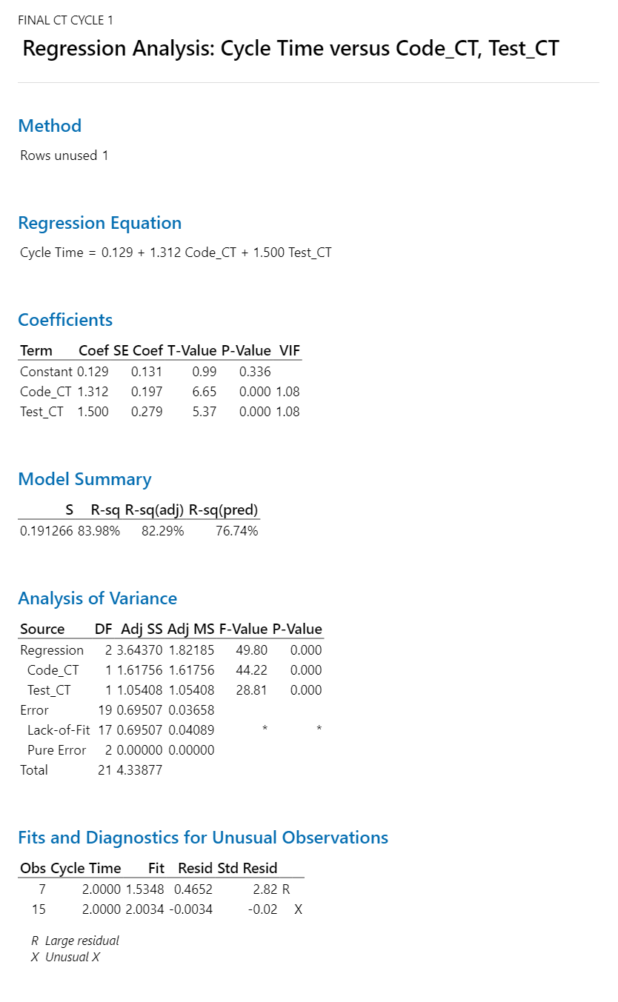
Y Factors
Cycle Time
X factors
Coding Time
Testing time

Slide 31
Data
Data Collection Sheet for Cycle 1 Cycle Time with all y Factors and x Factors calculation
Cycle Time | Code_CT | Test_CT
2.22 | 0.78 | 0.44
0.76 | 0.42 | 0.12
1.13 | 0.67 | 0.20
2.14 | 1.14 | 0.29
1.25 | 0.50 | 0.25
2.23 | 1.23 | 0.35
2.00 | 0.50 | 0.50
0.72 | 0.44 | 0.08
1.08 | 0.75 | 0.17
1.33 | 0.67 | 0.33
1.00 | 0.50 | 0.00
1.17 | 0.67 | 0.17
1.05 | 0.50 | 0.20
1.04 | 0.43 | 0.30
2.00 | 0.67 | 0.67
1.18 | 0.55 | 0.18
1.00 | 0.50 | 0.00
1.00 | 0.50 | 0.00
2.00 | 1.00 | 0.20
1.10 | 0.57 | 0.23
1.14 | 0.62 | 0.21
1.00 | 0.57 | 0.21
1.28 | 0.61 | 0.28
Regression Equation
Cycle Time | = | 0.129 + 1.312 Code_CT + 1.500 Test_CT

Slide 32
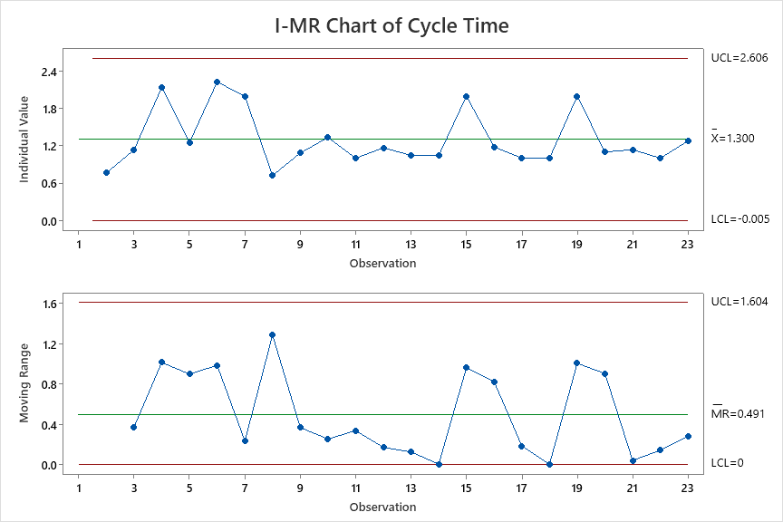
Control Chart – cycle Time

Slide 33
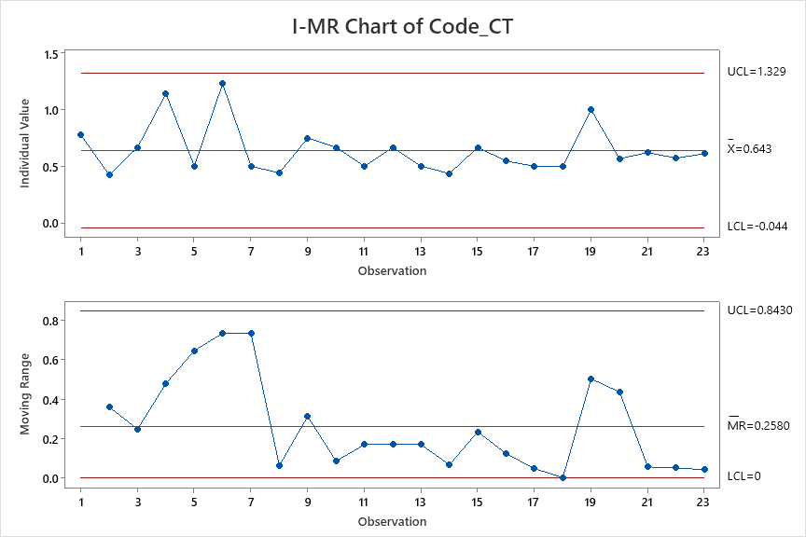
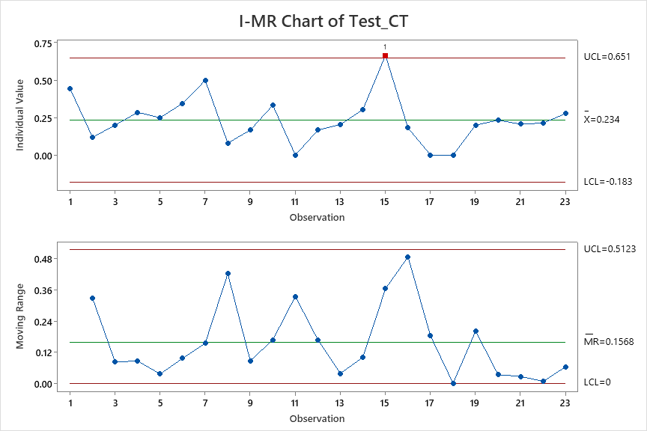
Control Chart – X Factor of cycle Time

Slide 34
Regression Equation – Cycle Time
Regression Equation
Cycle Time = 0.129 + 1.312 Code_CT + 1.500 Test_CT
Cycle 1

Slide 35
Performance and Targets – cycle time
The As Is Performance and What if analysis
As IS Performance Table with the performance of all Y and X Factors
Target Setting Table and What if Table
AS-IS | Cycle time | Code_CT | Test_CT
Mean | 1.3 | 0.643 | 0.234
SD | 0.435 | 0.229 | 0.139
UCL | 2.606 | 1.329 | 0.651
LCL | -0.005 | -0.044 | -0.183
Target | Cycle time
Mean | 1.17
SD | 0.25
What if | Cycle time | Code_CT | Test_CT
Mean | 1.170848 | 0.554 | 0.21
SD | 0.25 | 0.1 | 0.5
USL | 1.920848 | 0.854 | 1.71
LSL | -0.5 | -0.2 | -1
Cycle 1

Slide 36
Action Plan to achieve targets of Cycle time
Action plan to achieve the cycle time targets
Sr. No. | Metric | Phase | Action | Description | Improvements | Expected Outcome | Implementation Date | Responsibility | Status | Remarks / Notes | Process, Procedure, Implementation Plan
1 | Productivity | All Phase ( SDLC) | Improve Review Effeciency - Requirement Review , Design Review , Code Review , Test Cases Review and this will increase productivity | 1. Requirement Review : 1.1. Analyze the Current Process. 1.2 Prepare the SOP - Current Process & Revised Process ( Define Checklist , Review cooments captured ie., defect tracking sheet , Promot - option ) 1.3 Implementation Plan. 2. Design Review 2.1 Wireframe Review Process 2.2 Database Review Process 3. Code Review - Implement Code Review Checklist 4. Unit Test Cases Review - Peer Review unit test cases 5. Test Cases Review - | This will increases the productivity by 10% | To Increase / Improve the productivity rate for coding and testing. | 7-Aug-25 | BA,QA,TL | Complete |  | 1. Test Plan & Test Case Review Checklist- JAL REKHA 2. Jal Rekha Code Review Checklist 3. Jal Rekha-DesignReview _ Defects 1.0 4. Jal Rekha_FRS_REVIEW Ver 1.0 5. Mobile Code Review
2 | DRE | DRE | Improve the overall DRE | 1. Align the Customer UAT Team on the Scope of Testing . ( Test Cases / Test Scenarios ) 2.Analyze the Type of defects raised And accordingly decision. | This will improve the overall DRE by 5% | To decrease / reduce total review defects and total internal testing defect | 3rd Week Aug'25 | QA, TL, PM | Complete |  | 1) UAT Scope of defects added and analyze at both client and at development team level 2) PROD Scope of defects added and analyze at both client and at development team level
3 | Productivity/Cycle time | Coding | Re-estimate the scope changes | 1. Estimate the Scope 2. Coding 3. Addl. Changes that are requested by Customer/Client. 3.1 Update the Scope document with that changes. 3.2 Re-estimate the Size of the Changes. 3.3 Coding 3.4 Prepare Test Cases and Execution. 4. Sum the Size of the requirements against the total Actuial efforts to Calc Productivity. | This will Improve the Productivity and Cycle time by 5-10%. | To Increase / Improve the productivity rate for coding. | 4th Week Aug'25 | Developer, TL, PM | Complete |  | 1. Test Plan & Test Case Review Checklist- JAL REKHA 2. Jal Rekha Code Review Checklist 3. Jal Rekha-DesignReview _ Defects 1.0 4. Jal Rekha_FRS_REVIEW Ver 1.0 5. Mobile Code Review
Cycle 1

Slide 37
Cycle 2 (Cycle Time)

Slide 38
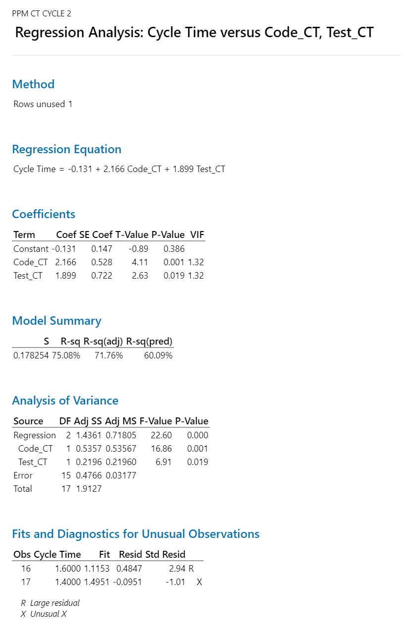
Y Factors
Cycle Time
X factors
Code Cycle Time
Test Cycle Time

Slide 39
Data for Cycle 2 Cycle time(data from the Data Collection Sheet )
Cycle Time | Code_CT | Test_CT
1.182 | 0.455 | 0.212
0.938 | 0.313 | 0.188
0.780 | 0.341 | 0.171
0.563 | 0.250 | 0.156
0.500 | 0.188 | 0.188
0.762 | 0.286 | 0.167
0.600 | 0.200 | 0.100
0.800 | 0.300 | 0.200
0.435 | 0.141 | 0.120
0.366 | 0.146 | 0.098
0.800 | 0.300 | 0.167
0.474 | 0.211 | 0.105
0.800 | 0.400 | 0.100
0.833 | 0.500 | 0.333
1.000 | 0.200 | 0.200
1.600 | 0.400 | 0.200
1.400 | 0.400 | 0.400
0.607 | 0.250 | 0.161
1.040 | 0.360 | 0.160
Regression Equation
Cycle Time | = | -0.131 + 2.166 Code_CT + 1.899 Test_CT

Slide 40
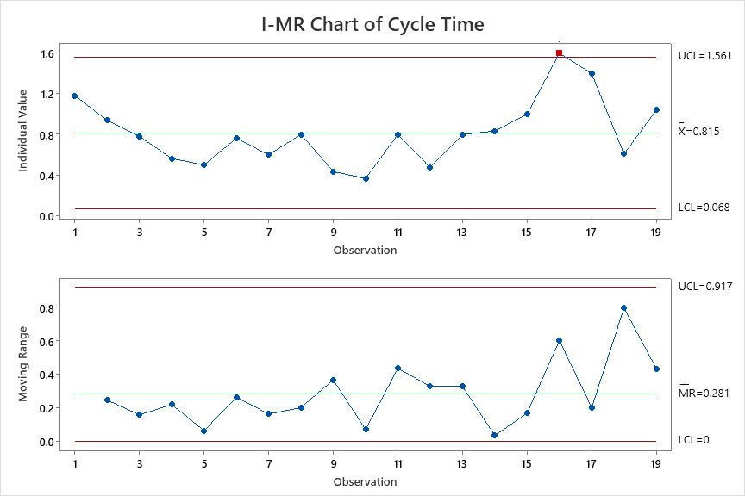
Control Chart – cycle time

Slide 41
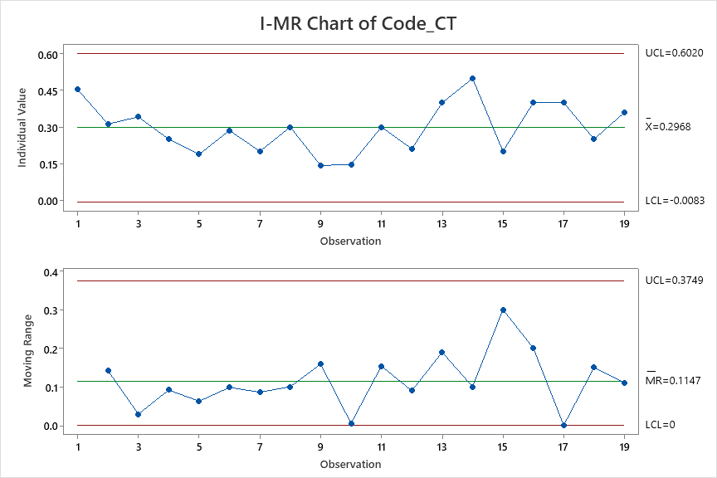
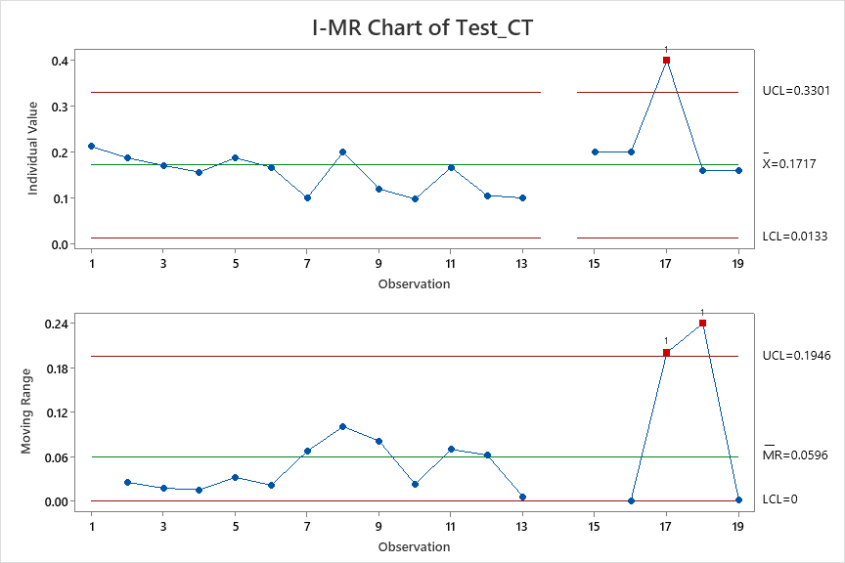
Control Chart – X Factors of cycle Time

Slide 42
Performance Comparison from cycle 1 & cycle 2
The As Is Performance and What if analysis - Of CYCLE TIME (Y FACTOR)
As IS Performance Table with the performance of Cycle 1 for all Y and X Factors
Target Setting Table and What if Table
AS-IS | Cycle time | Code_CT | Test_CT
Mean | 1.3 | 0.643 | 0.234
SD | 0.435 | 0.229 | 0.139
UCL | 2.606 | 1.329 | 0.651
LCL | -0.005 | -0.044 | -0.183
Target | Cycle time
Mean | 1.17
SD | 0.25
As IS Performance Table with the performance of Cycle 2 for all Y and X Factors
AS-IS | Cycle time | Code_CT | Test_CT
Mean | 0.815 | 0.2968 | 0.1717
SD | 0.249 | 0.102 | 0.053
UCL | 1.561 | 0.602 | 0.3301
LCL | 0.068 | -0.0083 | 0.0133
Cycle 1

Slide 43
Action Plan to achieve targets
Complete estimation of CR with-in 24 Hour after logging CR;
Involvement of Testing team members in Process briefing also;
Reduction of Defect to reduce re-testing;
Action Point | Metric/Category | Phase | Action/Task | Description | Improvements | Expected Outcome | Implementation Date | Responsibility | Status | Remarks / Notes | Process, Procedure, Implementation Plan
1 | DRE | All Phase ( SDLC) | Improve Review Efficiency – Requirement, Design, Code, and Test Case Reviews | 1. Requirement Review: Analyze current process, prepare SOP for current vs revised workflow, define checklists, capture review comments in defect tracking sheet. 2. Design Review: Implement structured wireframe and database review process. 3. Code Review: Enforce mandatory checklist-driven code reviews before merge. 4. Unit Test Case Review: Conduct peer review of developer test cases. 5. Functional Test Case Review: Peer review with UAT sign-off before execution. | Expected increase of review defects by 10–15%, enabling early defect detection. | Improved defect leakage prevention and higher product quality across SDLC stages | 4th Week Nov'25 | BA,QA,TL | Complete | Checklists created and implemented for Jal Rekha module. | Establish mandatory review gates in SDLC. No artifact moves to the next phase without review approval. Track review effectiveness monthly.
2 | DRE | Productivity- DRE and Code review rate | Reduce the overall DRE count | 1. UAT Alignment: Ensure customer UAT team tests strictly within approved scope using agreed test cases/scenarios. 2. Production Defect Analysis: Perform RCA on production defects and implement preventive fixes. 3. Strengthen Internal QA: Increase internal testing depth before release. | Reduction in DRE by approx. 2–3%. | To increas or improve the overall performance of DRE by working on total review defects, internal testing defects and code review defects. | 4th Week Nov'25 | QA, TL, PM | Complete | UAT and production defects now analyzed jointly by client and internal teams. | 1) UAT Scope of defects added and analyze at both client and at development team level 2) PROD Scope of defects added and analyze at both client and at development team level
3 | Cycle Time | All Phase ( SDLC) | Re-estimate Scope Changes and no last-minute changes | 1.Scope Estimation: Perform detailed effort estimation before development 2.Change Management: Any additional customer request must go through formal change control. • Update scope document. • Re-estimate effort and timeline. • Obtain stakeholder approval 3.Execution: Proceed with coding and testing only after approval 4.Productivity Tracking: Compare planned vs actual effort to measure variance | Productivity improvement of 5–10% through controlled scope and better estimation accuracy. | Faster development throughput and improved coding rate. | 3rd Week Nove'25 | Developer, TL, PM | Complete | Version control for all change requests Track versions of change requests | Set up a Change Control Board (CCB) for approvals Freeze sprint scope after planning Track estimation vs actuals and keep past data for better planning
4 | Cycle Time | Test cycle time | Optimize Testing Through Structured Sign-off and Resource Planning | 1. Formal Sign-off: Require requirement sign-off for new features and change requests. Create separate story points and track via versioning (Module–Submodule–vX.X). 2. Resource Planning: Allocate dedicated testers and maintain backup testers for critical cycles. 3. Effort-based Test Planning: Estimate testing effort based on scope complexity. 4. Parallel Activities: Begin test case preparation during development to reduce idle time. 5. Measure Test Consumption: Track planned vs actual testing time. | Test cycle reduction by 5–10%. | 1.Better testing, fewer delays 2.On-time releases | 3rd Week Nove'25 | TL, PM, QA | Complete | Backup tester model introduced for high-priority releases. | 1.Ensure build is test-ready before handover 2.Track daily testing progress 3.Daily bug review to avoid delays
Cycle 1

Slide 44
Cycle 3 – (Cycle Time)

Slide 45
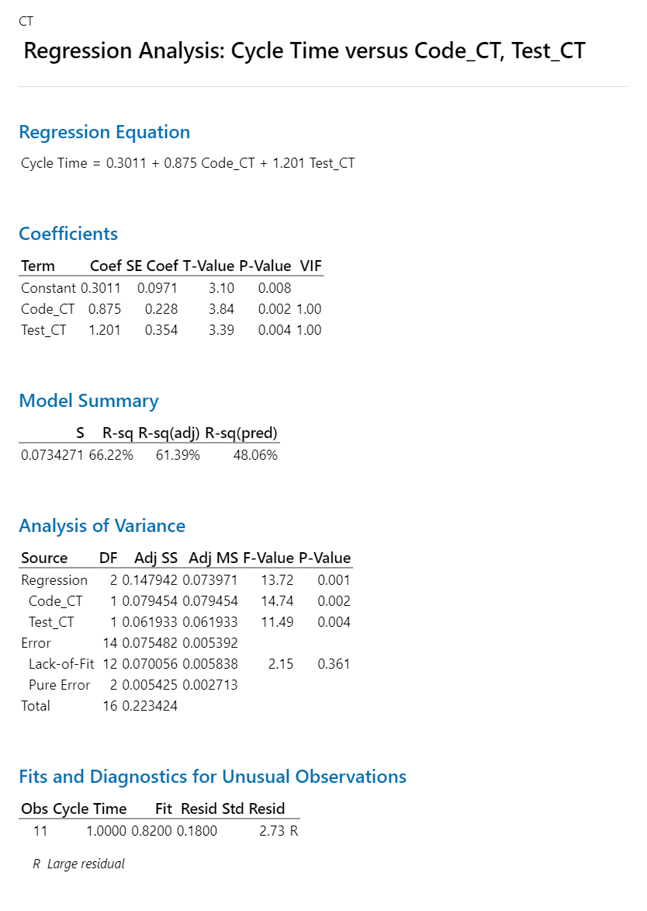
Y Factors
Cycle Time
X factors
Code Cycle Time
Test Cycle Time

Slide 46
Data for Cycle 2 Cycle time(data from the Data Collection Sheet )
Cycle Time | Code_CT | Test_CT
0.750 | 0.250 | 0.167
0.815 | 0.370 | 0.148
0.667 | 0.250 | 0.167
0.667 | 0.167 | 0.167
0.818 | 0.364 | 0.182
0.923 | 0.385 | 0.231
0.909 | 0.455 | 0.182
0.857 | 0.286 | 0.286
0.800 | 0.300 | 0.100
0.914 | 0.400 | 0.200
1.000 | 0.250 | 0.250
0.625 | 0.250 | 0.125
0.800 | 0.300 | 0.200
0.917 | 0.458 | 0.167
0.563 | 0.250 | 0.125
0.818 | 0.273 | 0.273
0.778 | 0.333 | 0.222
Regression Equation
Cycle Time | = | 0.3011 + 0.875 Code_CT + 1.201 Test_CT

Slide 47
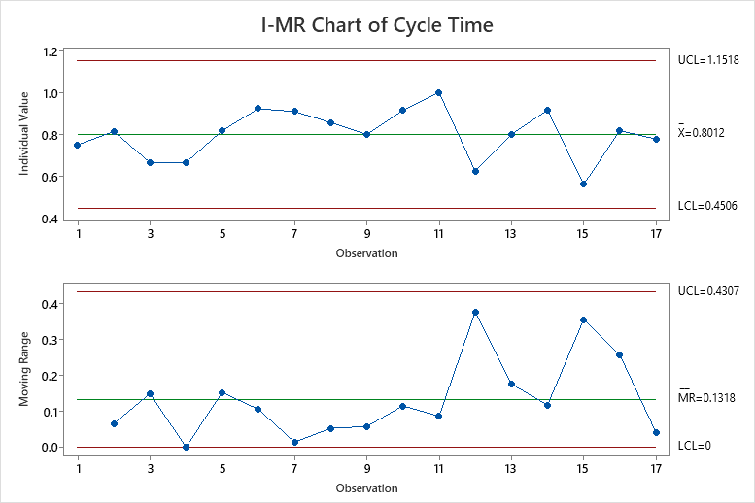
Control Chart – cycle time

Slide 48
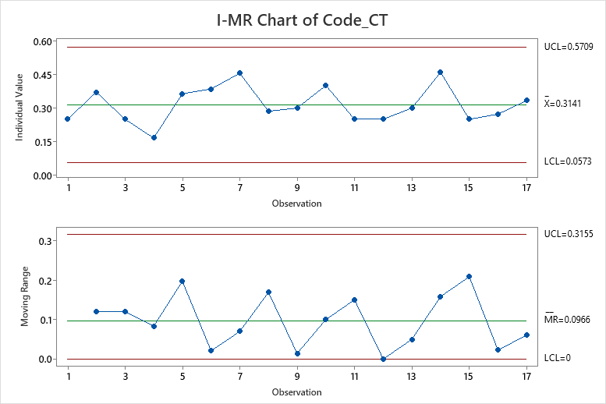
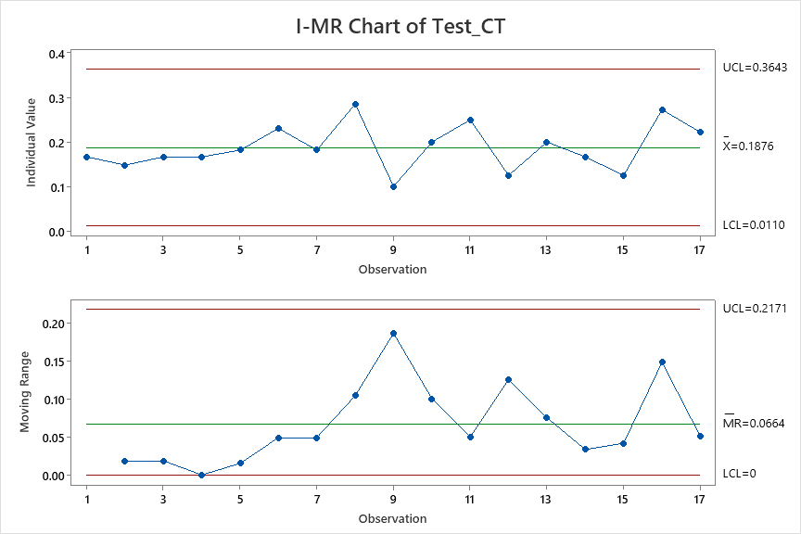
Control Chart – X Factors of cycle Time

Slide 49
Performance Comparison from cycle 2 & cycle 3
The As Is Performance and What if analysis - Of CYCLE TIME (Y FACTOR)
As IS Performance Table with the performance of Cycle 2 for all Y and X Factors
Target Setting Table and What if Table
AS-IS | Cycle time | Code_CT | Test_CT
Mean | 0.815 | 0.2968 | 0.1717
SD | 0.249 | 0.102 | 0.053
UCL | 1.561 | 0.602 | 0.3301
LCL | 0.068 | -0.0083 | 0.0133
Target | Cycle time
Mean | 0.7335
SD | 0.25
As IS Performance Table with the performance of Cycle 3 for all Y and X Factors
AS-IS | Cycle time | Code_CT | Test_CT
Mean | 0.8012 | 0.3141 | 0.1876
SD | 0.117 | 0.086 | 0.059
UCL | 1.1518 | 0.5709 | 0.3643
LCL | 0.4506 | 0.0573 | 0.011
Cycle 1

Slide 50
Action Plan to achieve targets Cycle 3 to Next
Complete estimation of CR with-in 24 Hour after logging CR;
Involvement of Testing team members in Process briefing also;
Reduction of Defect to reduce re-testing;
Action Point | Metric/Category | Phase | Action/Task | Description | Improvements | Expected Outcome | Implementation Date | Responsibility | Status | Remarks / Notes | Process, Procedure, Implementation Plan
1 | Code Rate | Development | Enforce Coding Standards with SonarQube Quality Gates | 1. Define standardized coding guidelines. 2. Configure SonarQube quality gates and thresholds. 3. Make quality checks mandatory before code merge. 4. Allocate dedicated time to refactor high-complexity code. 5. Monitor technical debt metrics regularly. | Reduces rework and technical debt by 15–25% | Improved developer efficiency and faster future enhancements. | 4th Week Nov'25 | TL, Developers, Architect | Complete | Especially important for billing module due to complex scenarios. | Integrate SonarQube into CI/CD pipeline. Block merges failing quality gates. Maintain technical debt register and review in sprint retrospectives.
Cycle 1

Slide 51
Cycle 1 (DRE)
Cycle 2 – Req an Code Leakage

Slide 52
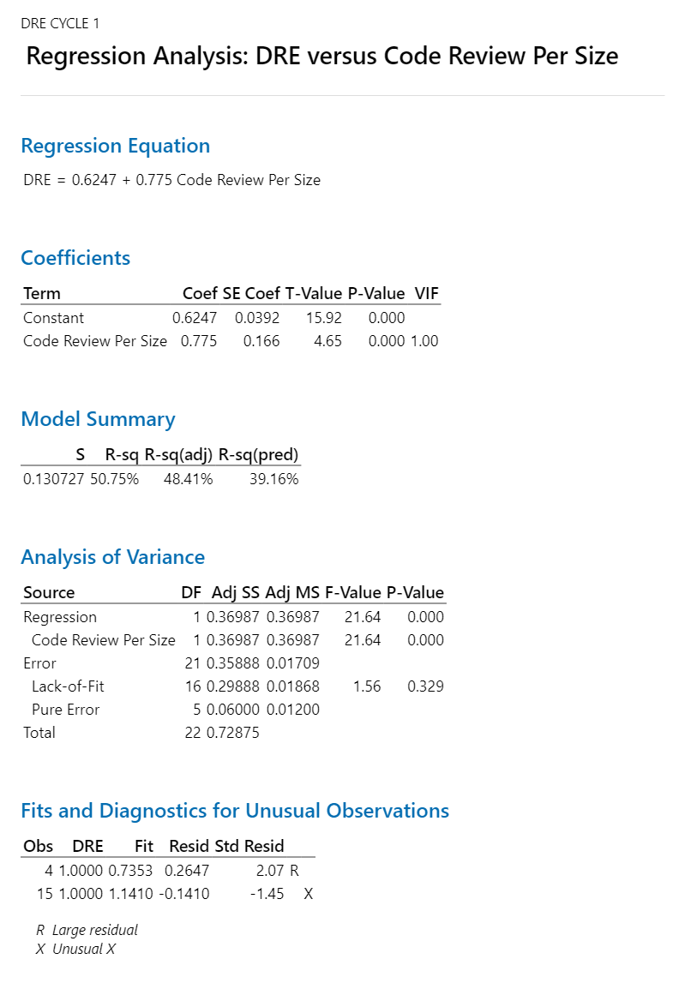
Y Factors
DRE
X factors
Code Review per Size

Slide 53
Data
DRE | Code Review Per Size
0.750 | 0.111
0.700 | 0.039
0.800 | 0.133
1.000 | 0.143
1.000 | 0.250
0.714 | 0.115
0.500 | 0.000
0.500 | 0.080
0.800 | 0.167
0.600 | 0.133
1.000 | 0.500
1.000 | 0.167
0.571 | 0.045
0.833 | 0.130
1.000 | 0.667
0.800 | 0.182
0.500 | 0.000
1.000 | 0.500
0.667 | 0.200
0.600 | 0.067
0.500 | 0.069
0.800 | 0.143
0.750 | 0.056
Regression Equation
DRE | = | 0.6247 + 0.775 Code Review Per Size
Cycle 2 – Req and Code Leakage

Slide 54
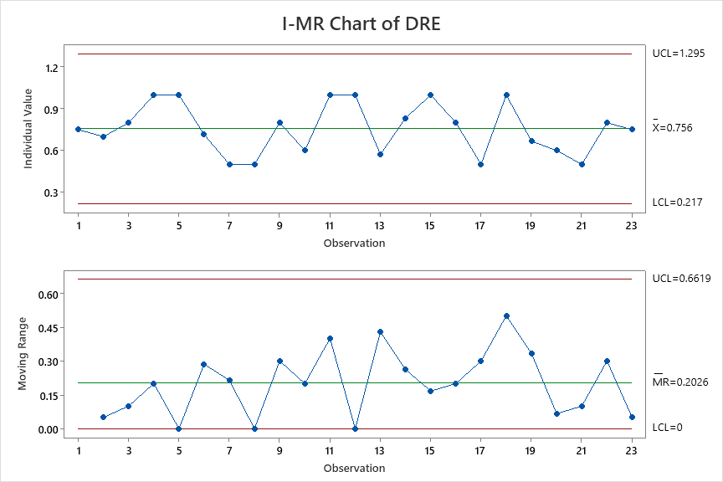
Control Chart – DRE
Cycle 2 – Req an Code Leakage

Slide 55
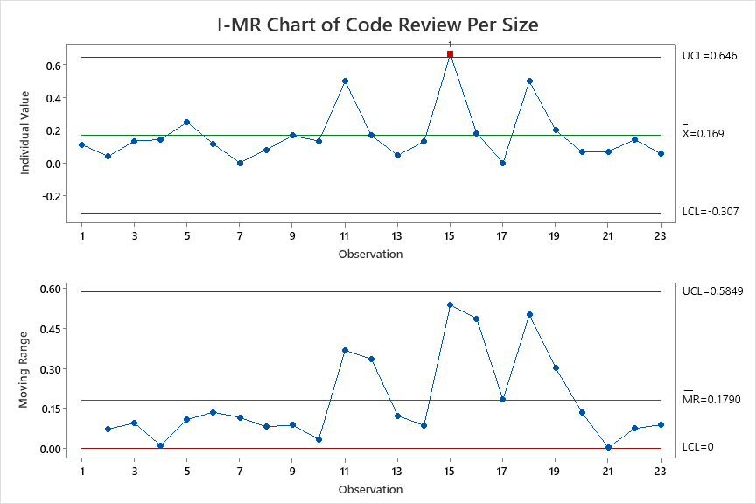
Control Chart – x Factors
Cycle 2 – Req an Code Leakage

Slide 56
DRE
Regression Analysis:
The regression equation is:
DRE = 0.6247 + 0.775 Code Review Per Size
Cycle 2 – Req an Code Leakage

Slide 57
Performance and Targets – DRE / QA-TDD
The AS IS Performance and What if analysis
As IS Performance Table with the performance of all Y and X Factors
Target Setting Table and What if Table
AS-IS | DRE | Code Review Per Size
Mean | 0.756 | 0.169
SD | 0.180 | 0.159
UCL | 1.295 | 0.646
LCL | 0.217 | -0.307
What if | DRE | Code Review Per Size
Mean | 0.7952 | 0.22
SD | 0.1 | 0.05
USL | 1.0952 | 0.37
LSL | 0.4952 | 0.07
Target | DRE
Mean | 0.79
SD | 0.10
Cycle 1

Slide 58
Action Plan to achieve targets
DRE action plan here
Sr. No. | Metric | Phase | Action | Description | Improvements | Expected Outcome | Implementation Date | Responsibility | Status | Remarks / Notes | Process, Procedure, Implementation Plan
1 | Productivity | All Phase ( SDLC) | Improve Review Effeciency - Requirement Review , Design Review , Code Review , Test Cases Review and this will increase productivity | 1. Requirement Review : 1.1. Analyze the Current Process. 1.2 Prepare the SOP - Current Process & Revised Process ( Define Checklist , Review cooments captured ie., defect tracking sheet , Promot - option ) 1.3 Implementation Plan. 2. Design Review 2.1 Wireframe Review Process 2.2 Database Review Process 3. Code Review - Implement Code Review Checklist 4. Unit Test Cases Review - Peer Review unit test cases 5. Test Cases Review - | This will increases the productivity by 10% | To Increase / Improve the productivity rate for coding and testing. | 7-Aug-25 | BA,QA,TL | Complete |  | 1. Test Plan & Test Case Review Checklist- JAL REKHA 2. Jal Rekha Code Review Checklist 3. Jal Rekha-DesignReview _ Defects 1.0 4. Jal Rekha_FRS_REVIEW Ver 1.0 5. Mobile Code Review
2 | DRE | DRE | Improve the overall DRE | 1. Align the Customer UAT Team on the Scope of Testing . ( Test Cases / Test Scenarios ) 2.Analyze the Type of defects raised And accordingly decision. | This will improve the overall DRE by 5% | To decrease / reduce total review defects and total internal testing defect | 3rd Week Aug'25 | QA, TL, PM | Complete |  | 1) UAT Scope of defects added and analyze at both client and at development team level 2) PROD Scope of defects added and analyze at both client and at development team level
Cycle 2 – Req and Code Leakage

Slide 59
Cycle 2 – DRE

Slide 60
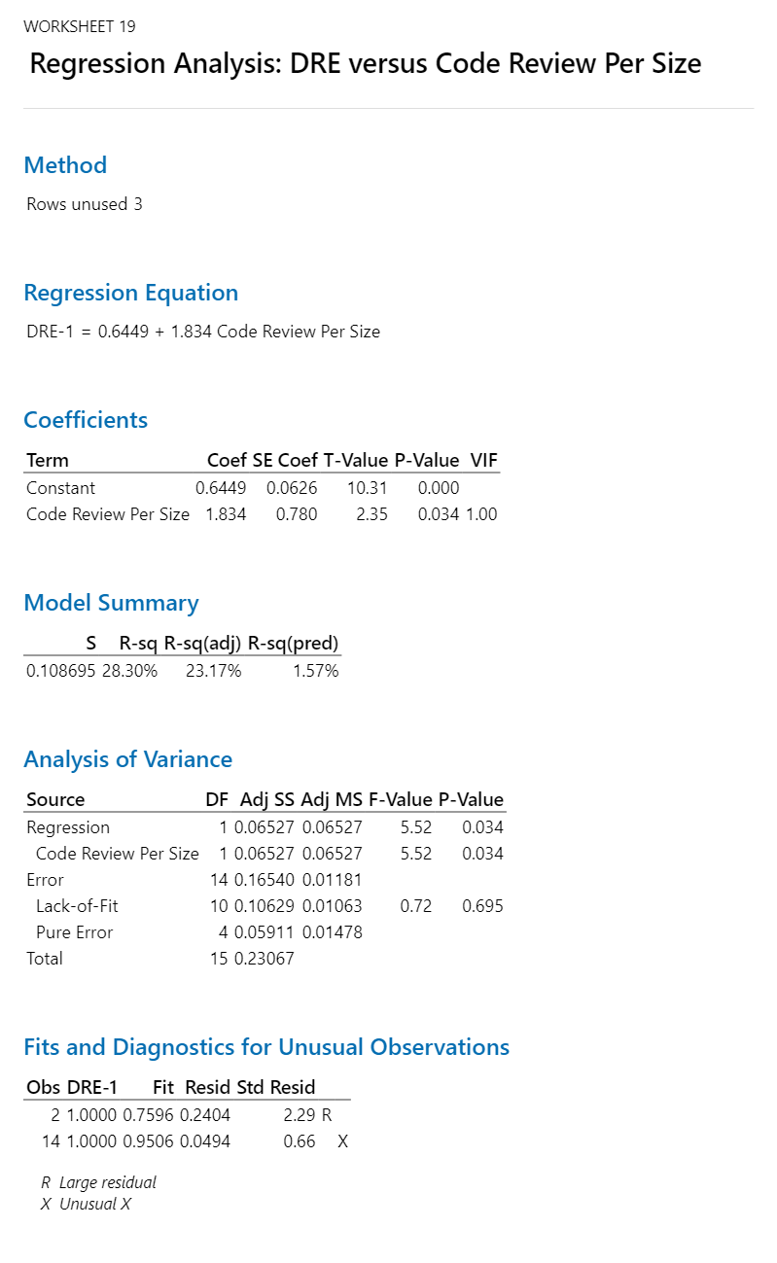
Y Factors
DRE
X factors
Code Review per Size

Slide 61
Data
DRE-1 | Code Review Per Size
0.800 | 0.091
1.000 | 0.063
0.800 | 0.073
0.800 | 0.063
0.667 | 0.063
0.800 | 0.071
0.667 | 0.100
0.667 | 0.100
0.714 | 0.033
0.875 | 0.073
0.800 | 0.067
0.800 | 0.079
0.750 | 0.100
1.000 | 0.167
0.500 | 0.000
0.600 | 0.200
0.667 | 0.200
0.800 | 0.035
0.750 | 0.080
Regression Equation
DRE-1 | = | 0.6449 + 1.834 Code Review Per Size
Cycle 1 – Req an Code Leakage

Slide 62
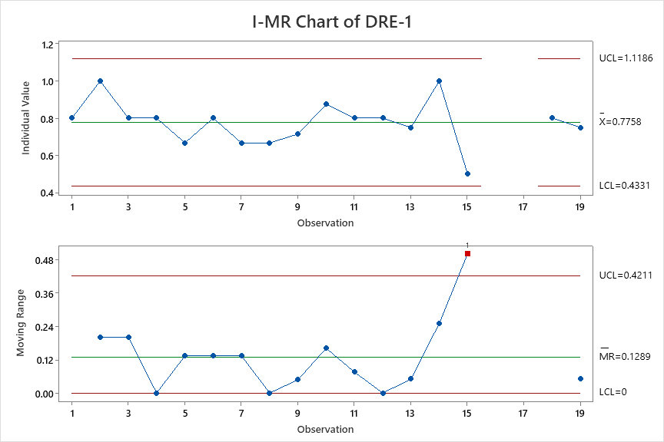
Control Charts
Cycle 3 – Req and Code Leakage

Slide 63
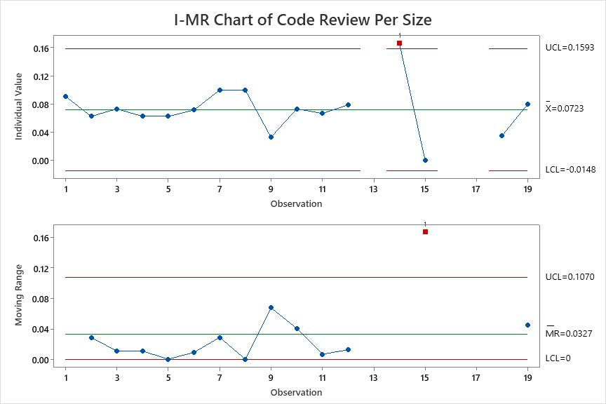
Control Chart – x Factors
Cycle 3 – Req and Code Leakage

Slide 64
DRE
Regression Analysis:
The regression equation is:
Regression Equation
DRE-1 = 0.6449 + 1.834 Code Review Per Size
Cycle 3 – Req and Code Leakage

Slide 65
Performance Comparison from cycle 1 & cycle 2
The As Is Performance and What if analysis - DRE (Y FACTOR)
As IS Performance Table with the performance of Cycle 1 for all Y and X Factors
Target Setting Table and What if Table
AS-IS | DRE | Code Review Per Size
Mean | 0.756 | 0.169
SD | 0.180 | 0.159
UCL | 1.295 | 0.646
LCL | 0.217 | -0.307
Target | DRE
Mean | 0.81
SD | 0.10
As IS Performance Table with the performance of Cycle 2 for all Y and X Factors
AS-IS | DRE | Code Review Per Size
Mean | 0.776 | 0.0723
SD | 0.114 | 0.029
UCL | 1.1186 | 0.1593
LCL | 0.4331 | -0.0148
Cycle 1

Slide 66
Cycle 3 – DRE

Slide 67
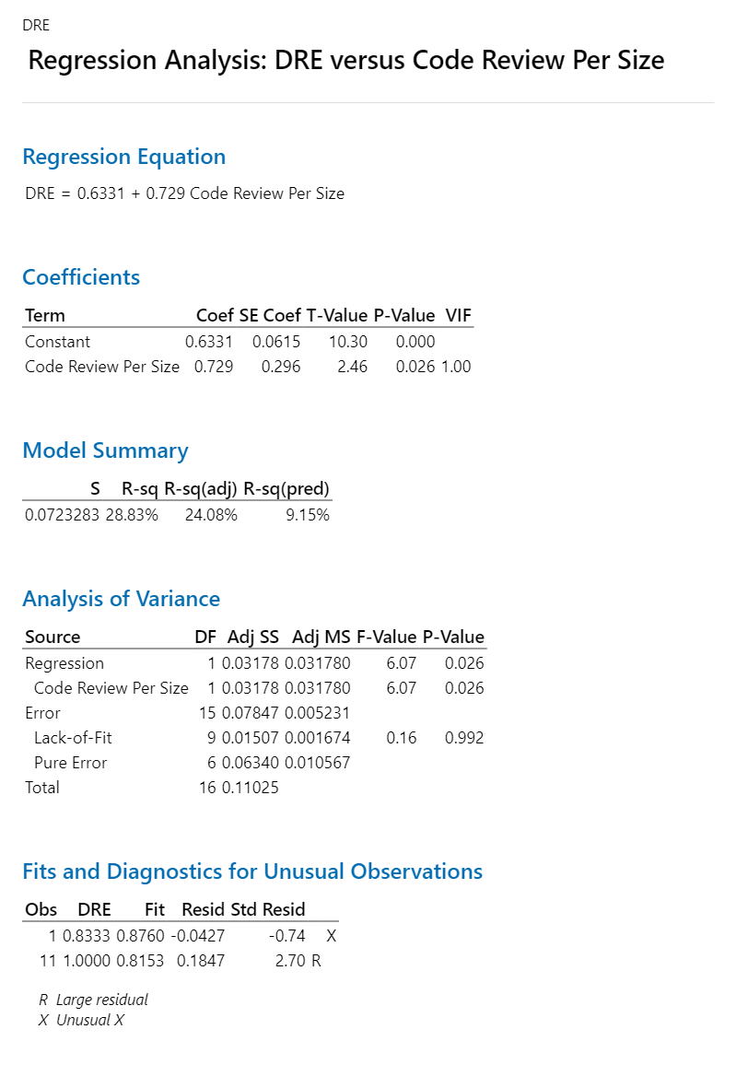
Y Factors
DRE / QA-TDD
X factors
Code Review per Size

Slide 68
Data
DRE | Code Review Per Size
0.83 | 0.33
0.83 | 0.22
0.75 | 0.17
0.67 | 0.17
0.80 | 0.23
0.83 | 0.23
0.75 | 0.18
0.67 | 0.14
0.78 | 0.20
0.75 | 0.09
1.00 | 0.25
0.75 | 0.25
0.75 | 0.20
0.88 | 0.17
0.78 | 0.25
0.67 | 0.09
0.75 | 0.22
Regression Equation
DRE | = | 0.6331 + 0.729 Code Review Per Size
Cycle 1 – Req an Code Leakage

Slide 69
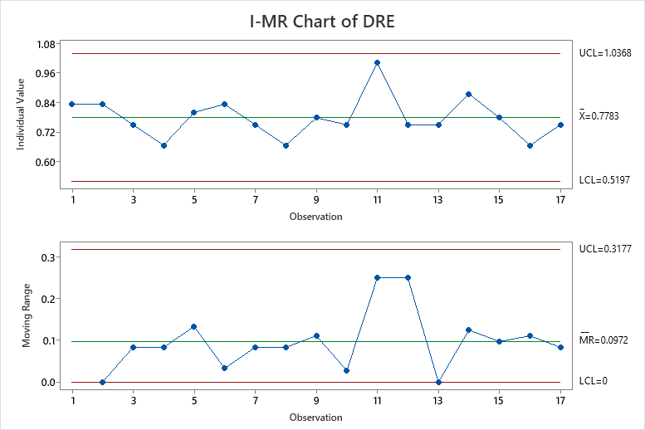
Control Charts
Cycle 3 – Req and Code Leakage

Slide 70
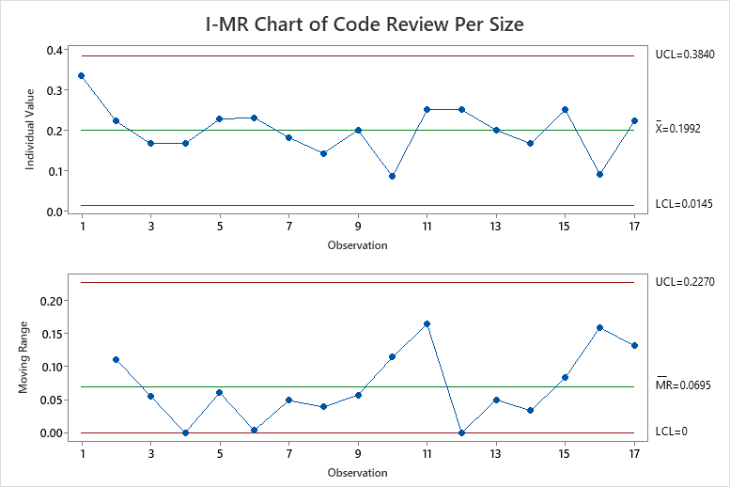
Control Chart – x Factors
Cycle 3 – Req and Code Leakage

Slide 71
DRE
Regression Analysis:
The regression equation is:
Regression Equation
DRE = 0.6331 + 0.729 Code Review Per Size
Cycle 3 – Req and Code Leakage

Slide 72
Performance Comparison from cycle 2 & cycle 3
The As Is Performance and What if analysis - DRE (Y FACTOR)
As IS Performance Table with the performance of Cycle 2 for all Y and X Factors
Target Setting Table and What if Table
AS-IS | DRE | Code Review Per Size
Mean | 0.776 | 0.0723
SD | 0.114 | 0.029
UCL | 1.1186 | 0.1593
LCL | 0.4331 | -0.0148
Target | DRE
Mean | 0.81
SD | 0.10
As IS Performance Table with the performance of Cycle 3 for all Y and X Factors
AS-IS | DRE | Code Review Per Size
Mean | 0.778 | 0.1992
SD | 0.086 | 0.062
UCL | 1.0368 | 0.384
LCL | 0.5197 | 0.0145
Cycle 1

Slide 73
Results
Cycle 3 – Req and Code Leakage

Slide 74
2 Sample t Test & f Test 2 sample t Test and F Test from Minitab and justification for the following 1. Productivity All Cycle Comparison 2. Cycle Time All Cycle Comparison 3. DRE All Cycle Comparison

Slide 75
2t – Productivity (cycle 1 & cycle 2 & Cycle 3)
Two-Sample T-Test and CI: C1_Productivity, C3_Productivity
Method
μ₁: population mean of C1_Productivity
µ₂: population mean of C3_Productivity
Difference: μ₁ - µ₂
Equal variances are not assumed for this analysis.
Descriptive Statistics
Sample N Mean StDev SE Mean
C1_Productivity 5 0.673 0.205 0.092
C3_Productivity 9 0.997 0.126 0.042
Estimation for Difference
Difference 95% CI for Difference
-0.324 (-0.584, -0.064)
Test
Null hypothesis H₀: μ₁ - µ₂ = 0
Alternative hypothesis H₁: μ₁ - µ₂ ≠ 0
T-Value DF P-Value
-3.21 5 0.024

Slide 76
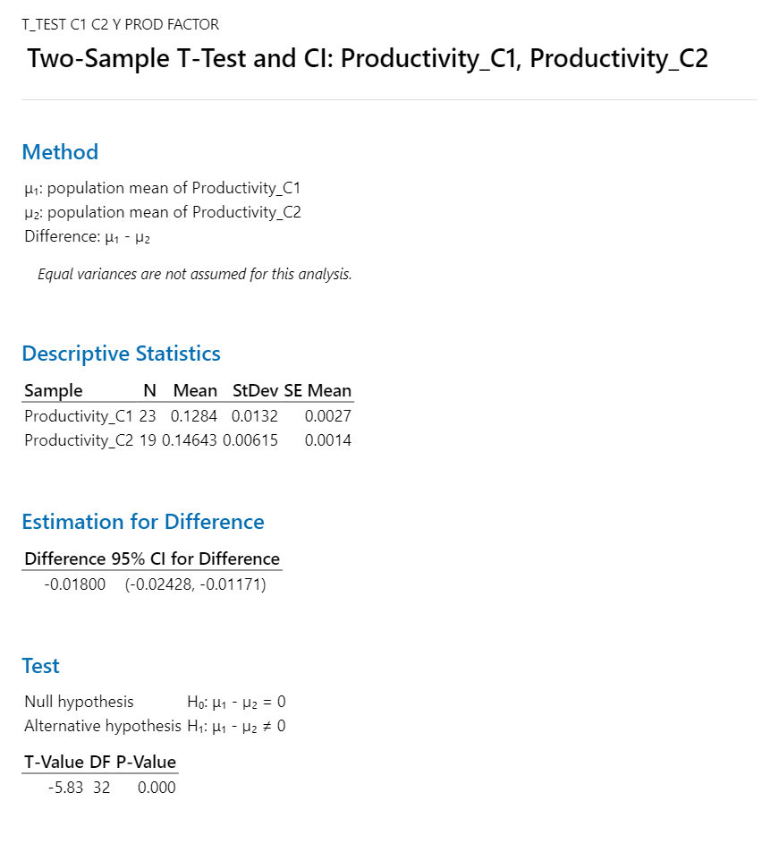
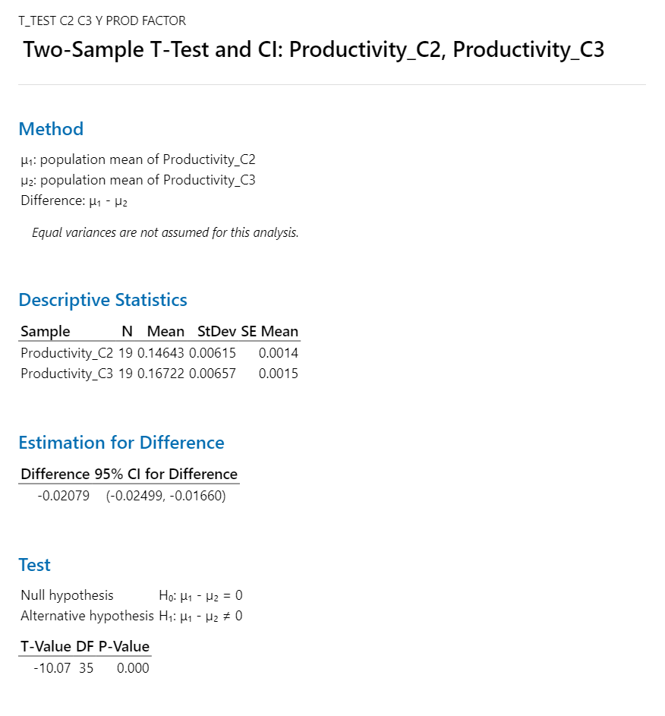
2t – Productivity (cycle 1 & cycle 2 & Cycle 3)

Slide 77
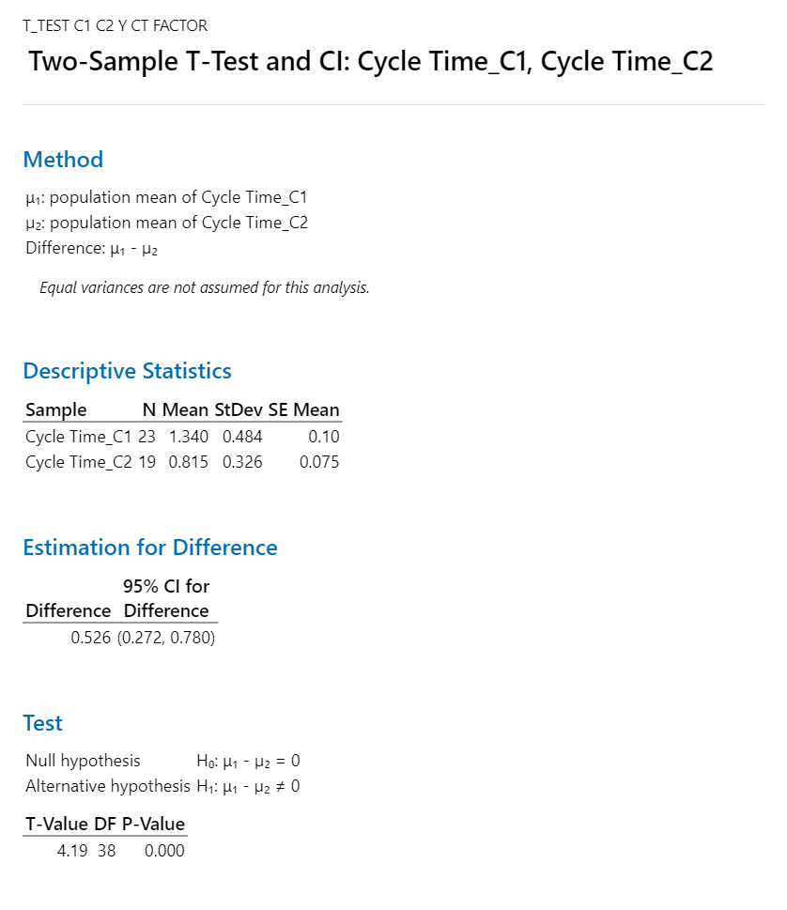
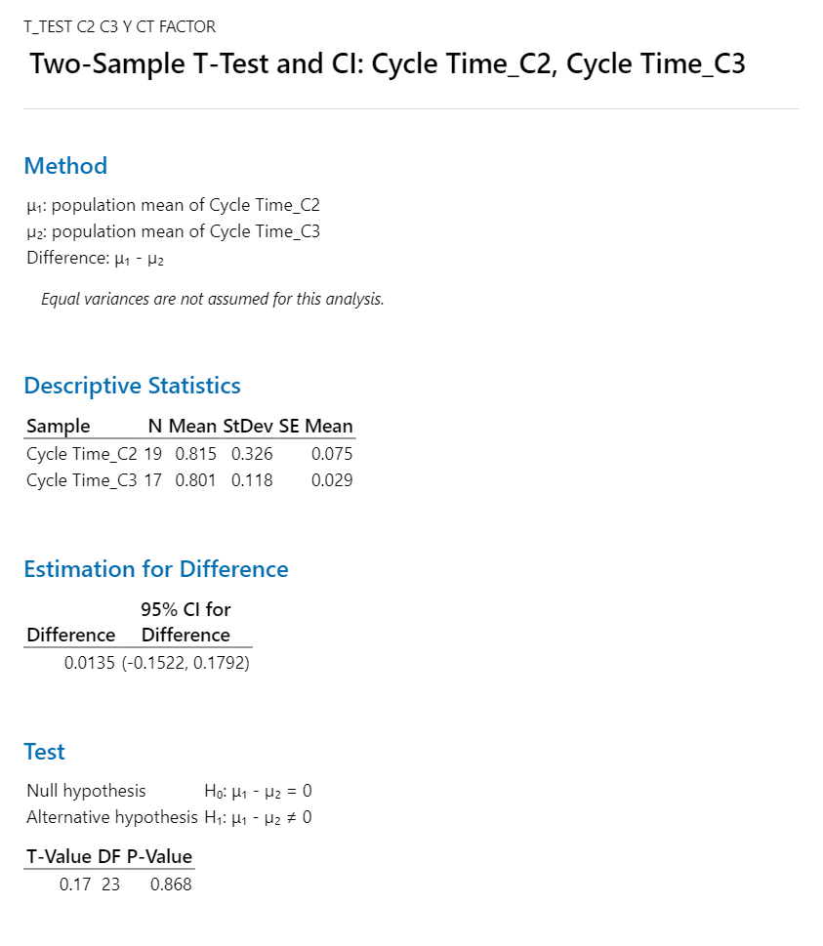
2t – Cycle Time(cycle 1 & cycle 2 & Cycle 3)

Slide 78
2t – Code Rate
Two-Sample T-Test and CI: C1_Code Rate, C3_Code Rate
Method
μ₁: population mean of C1_Code Rate
µ₂: population mean of C3_Code Rate
Difference: μ₁ - µ₂
Equal variances are not assumed for this analysis.
Descriptive Statistics
Sample N Mean StDev SE Mean
C1_Code Rate 5 1.406 0.969 0.43
C3_Code Rate 9 2.271 0.510 0.17
Estimation for Difference
Difference 95% CI for Difference
-0.865 (-2.062, 0.332)
Test
Null hypothesis H₀: μ₁ - µ₂ = 0
Alternative hypothesis H₁: μ₁ - µ₂ ≠ 0
T-Value DF P-Value
-1.86 5 0.122

Slide 79
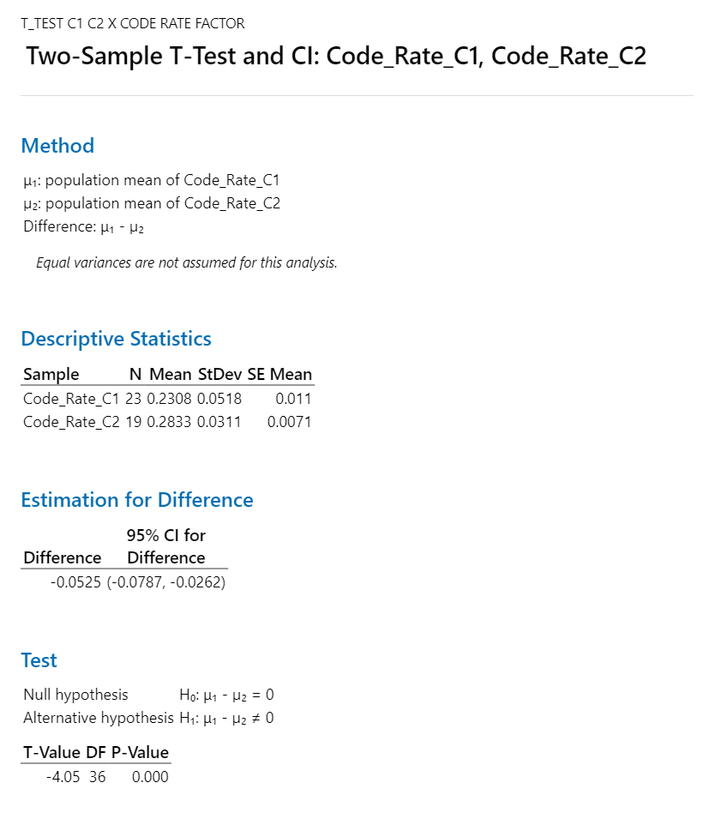

2t – Code Rate

Slide 80
2t – Test Rate
Two-Sample T-Test and CI: C1_Release planning+UATsupport, C3_Release planning+UATsupport
Method
μ₁: population mean of C1_Release planning+UATsupport
µ₂: population mean of C3_Release planning+UATsupport
Difference: μ₁ - µ₂
Equal variances are not assumed for this analysis.
Descriptive Statistics
Sample N Mean StDev SE Mean
C1_Release planning+UATsupport 5 0.265 0.184 0.082
C3_Release planning+UATsupport 9 0.178 0.124 0.041
Estimation for Difference
Difference 95% CI for Difference
0.0866 (-0.1387, 0.3120)
Test
Null hypothesis H₀: μ₁ - µ₂ = 0
Alternative hypothesis H₁: μ₁ - µ₂ ≠ 0
T-Value DF P-Value
0.94 6 0.383

Slide 81
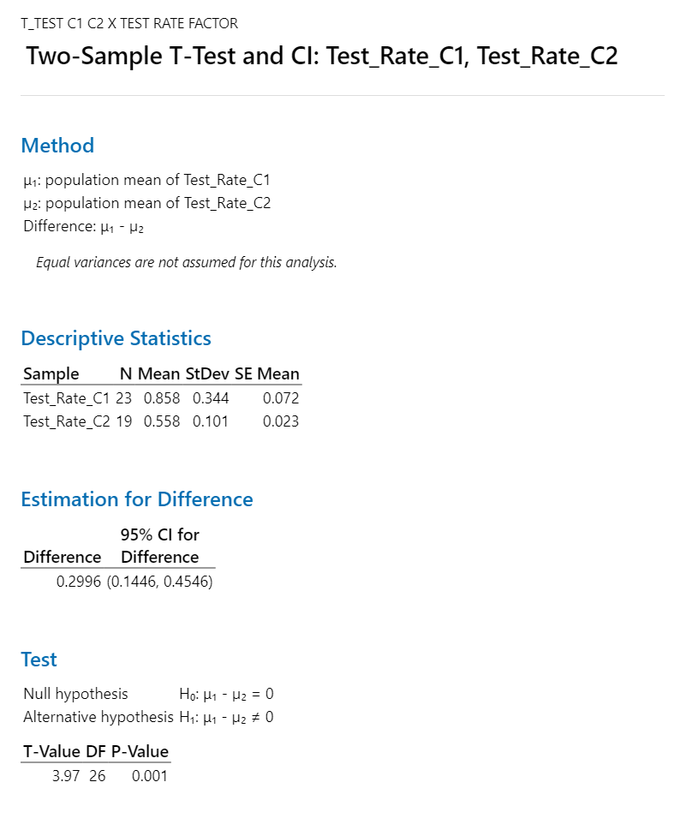
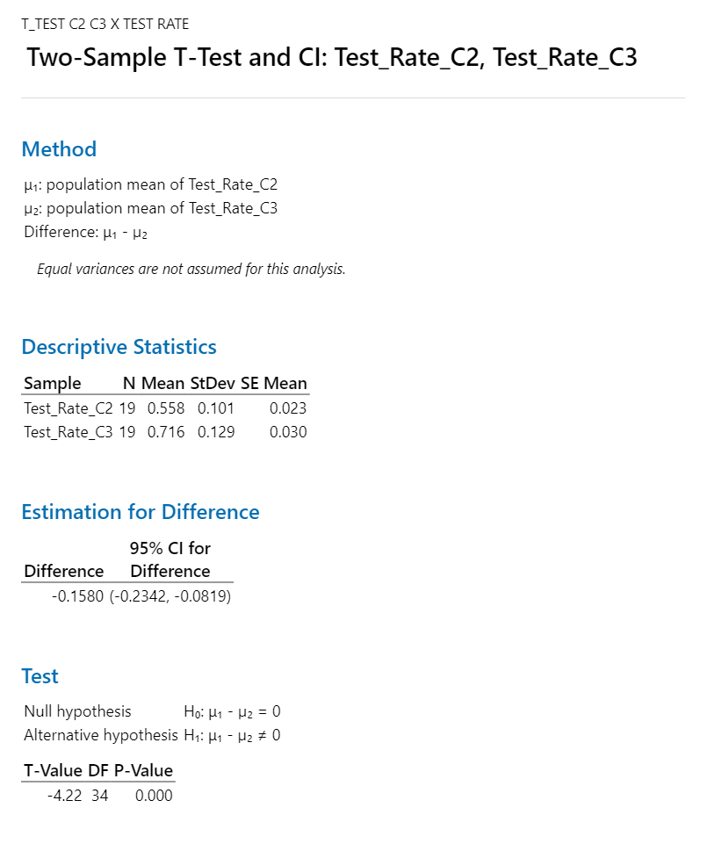
2t – Test Rate

Slide 82
Results
Productivity Improved
Code Rate Improved
Release planning + UAT support effort decreased
Cycle 2

Slide 83
Sample F Test Sample F Test from Minitab and justification for the following 1. Productivity All Cycle Comparison 2. Cycle Time All Cycle Comparison 3. DRE All Cycle Comparison

Slide 84
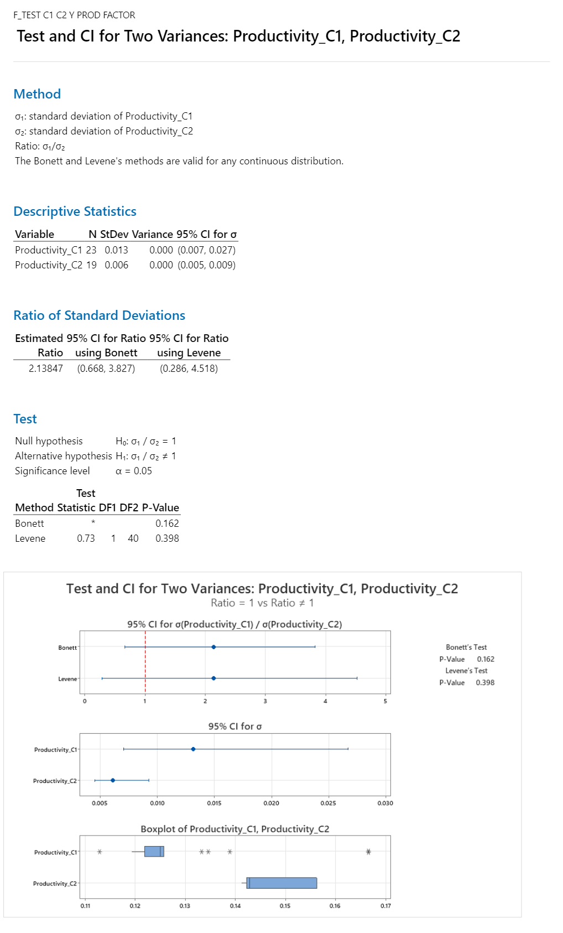
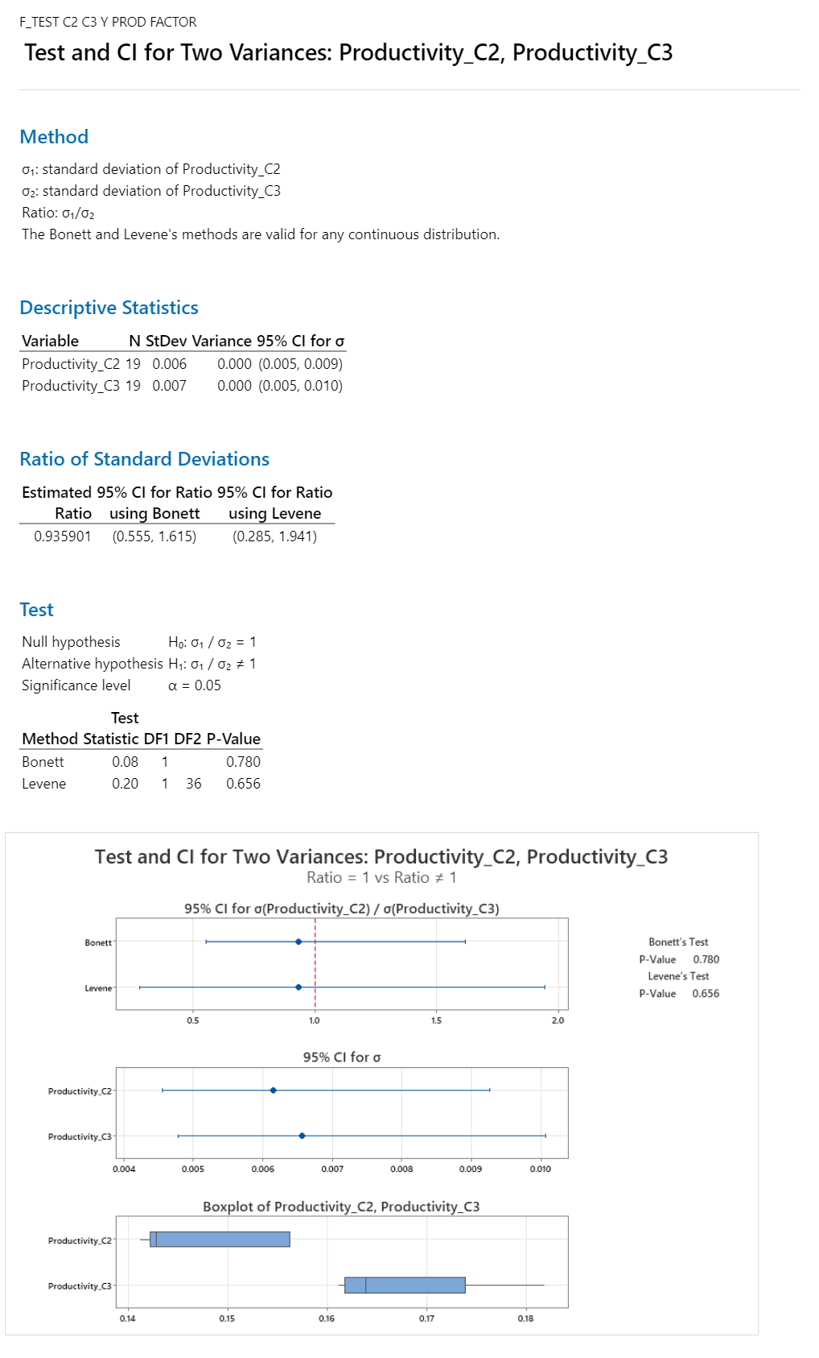
F Test – Productivity (cycle 1 & cycle 2 & Cycle 3)

Slide 85
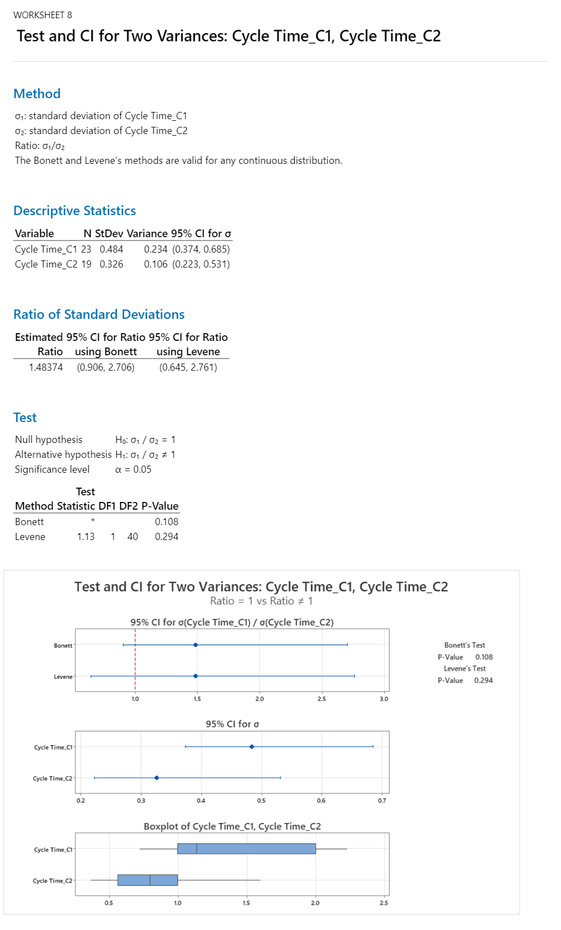
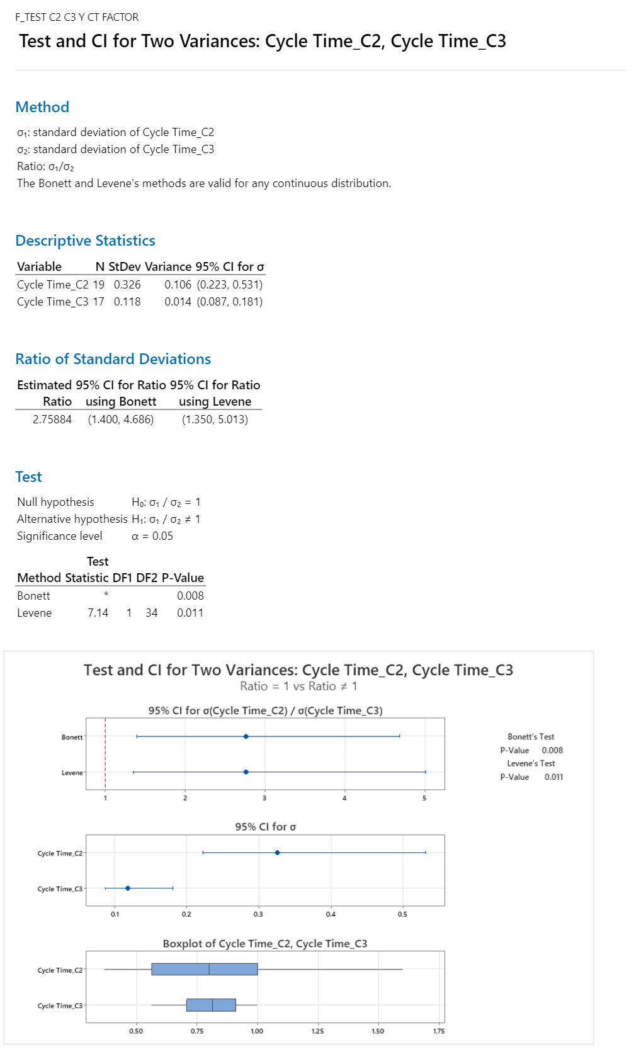
F Test – Cycle Time(cycle 1 & cycle 2 & Cycle 3)

Slide 86
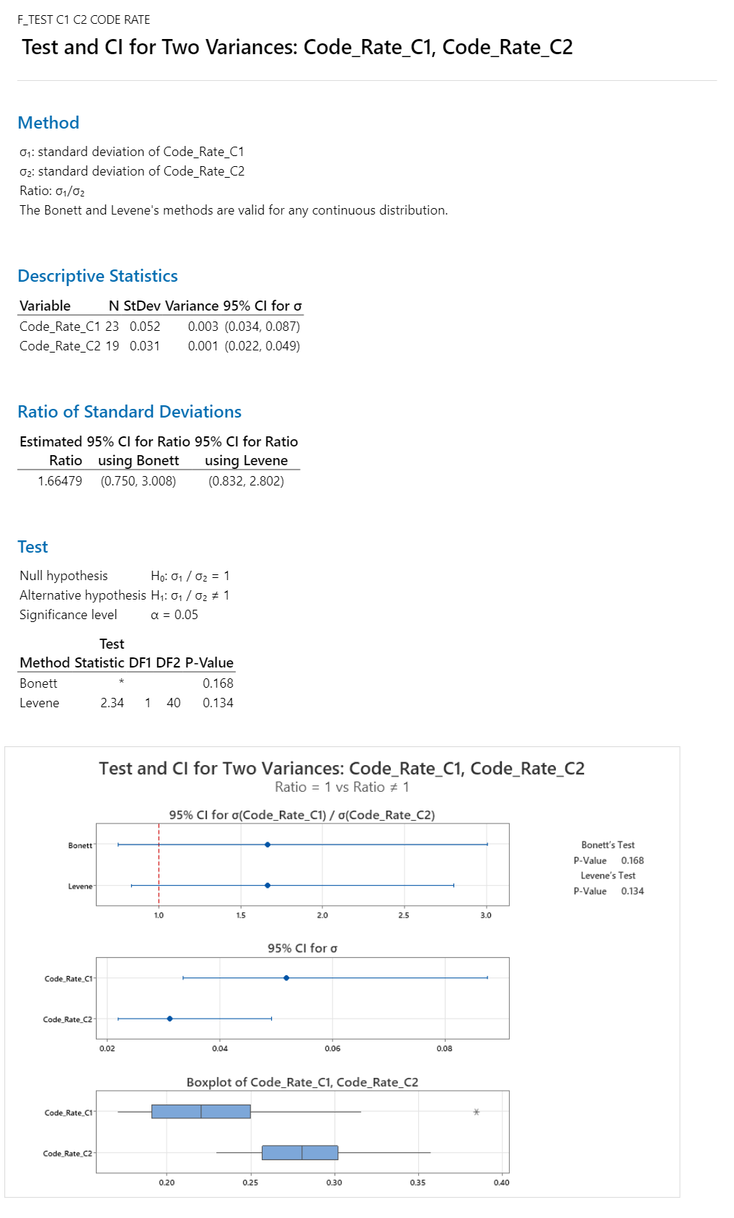
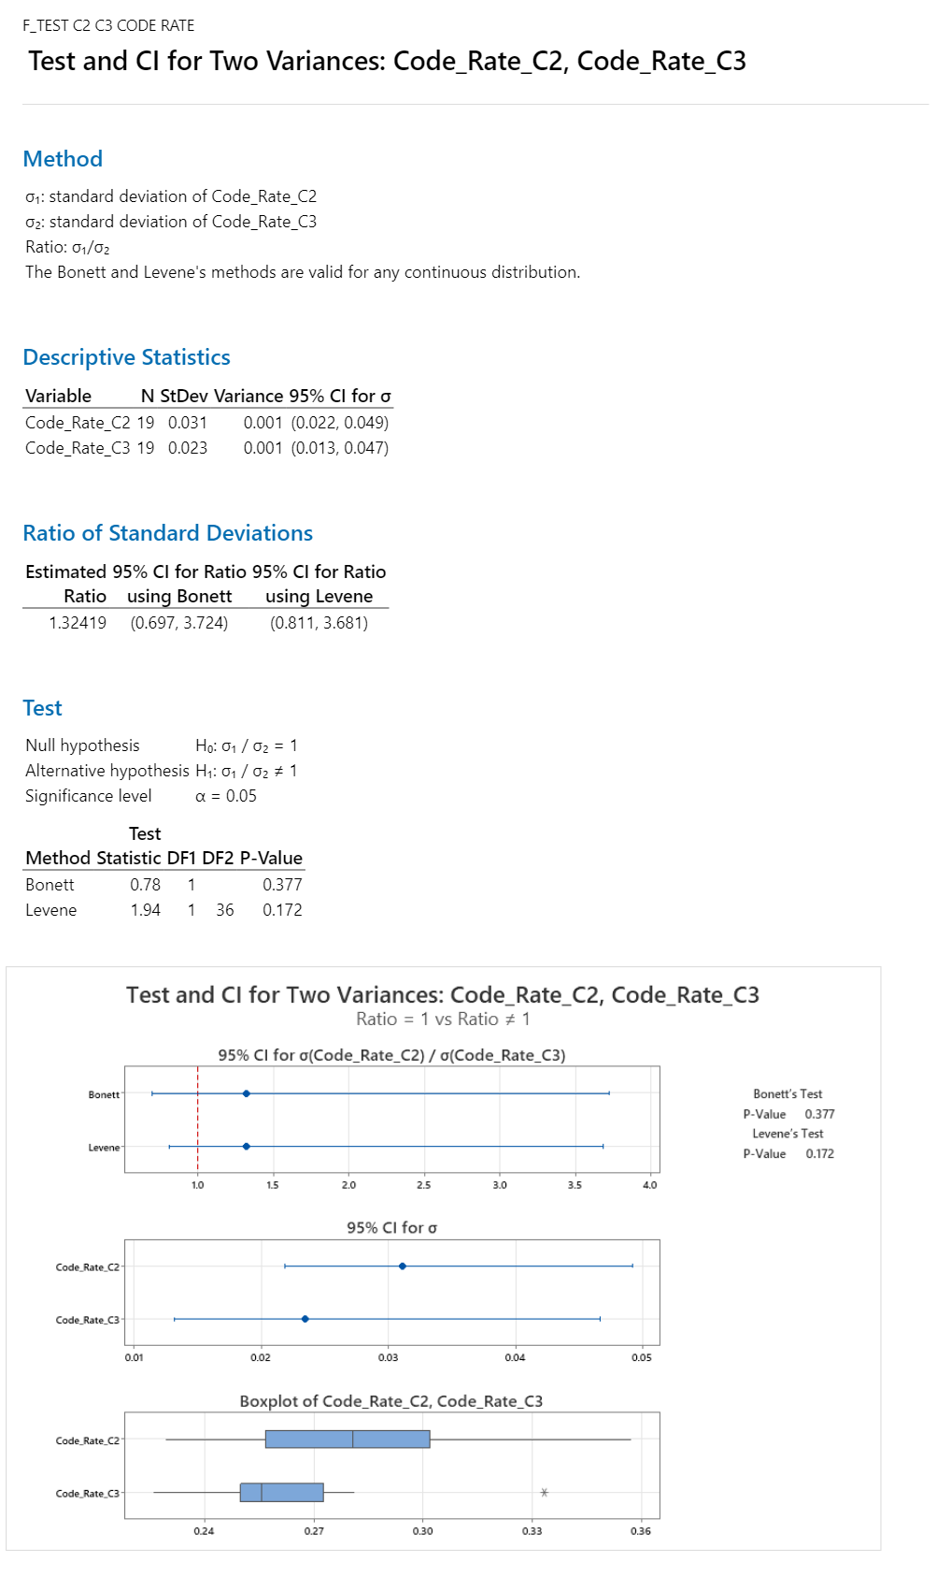
F Test – Code Rate

Slide 87
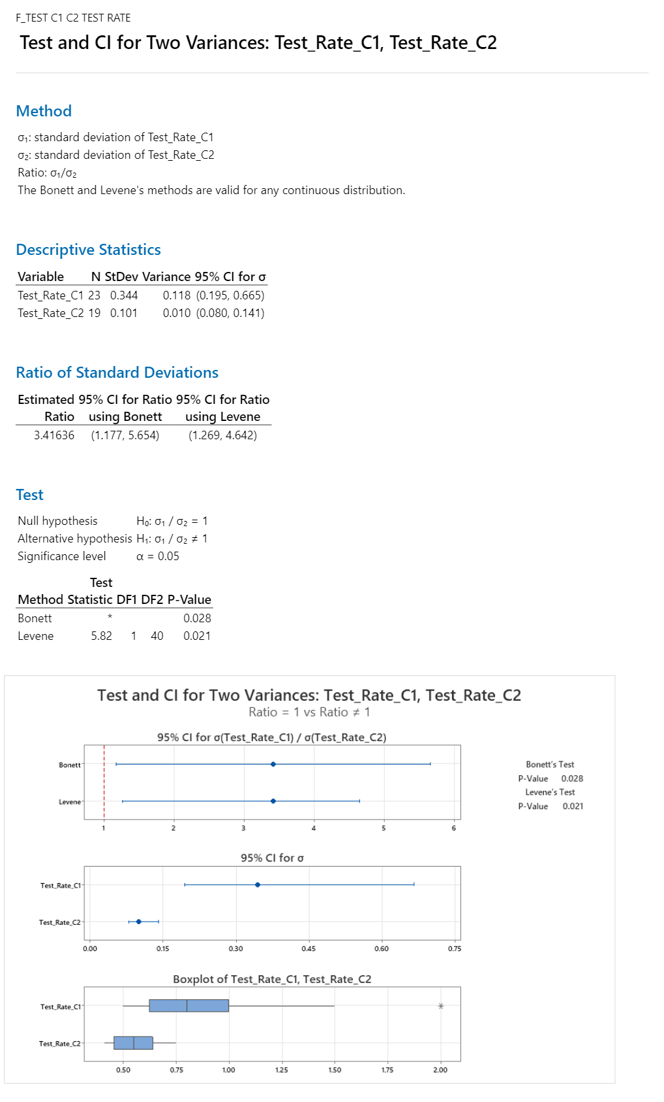
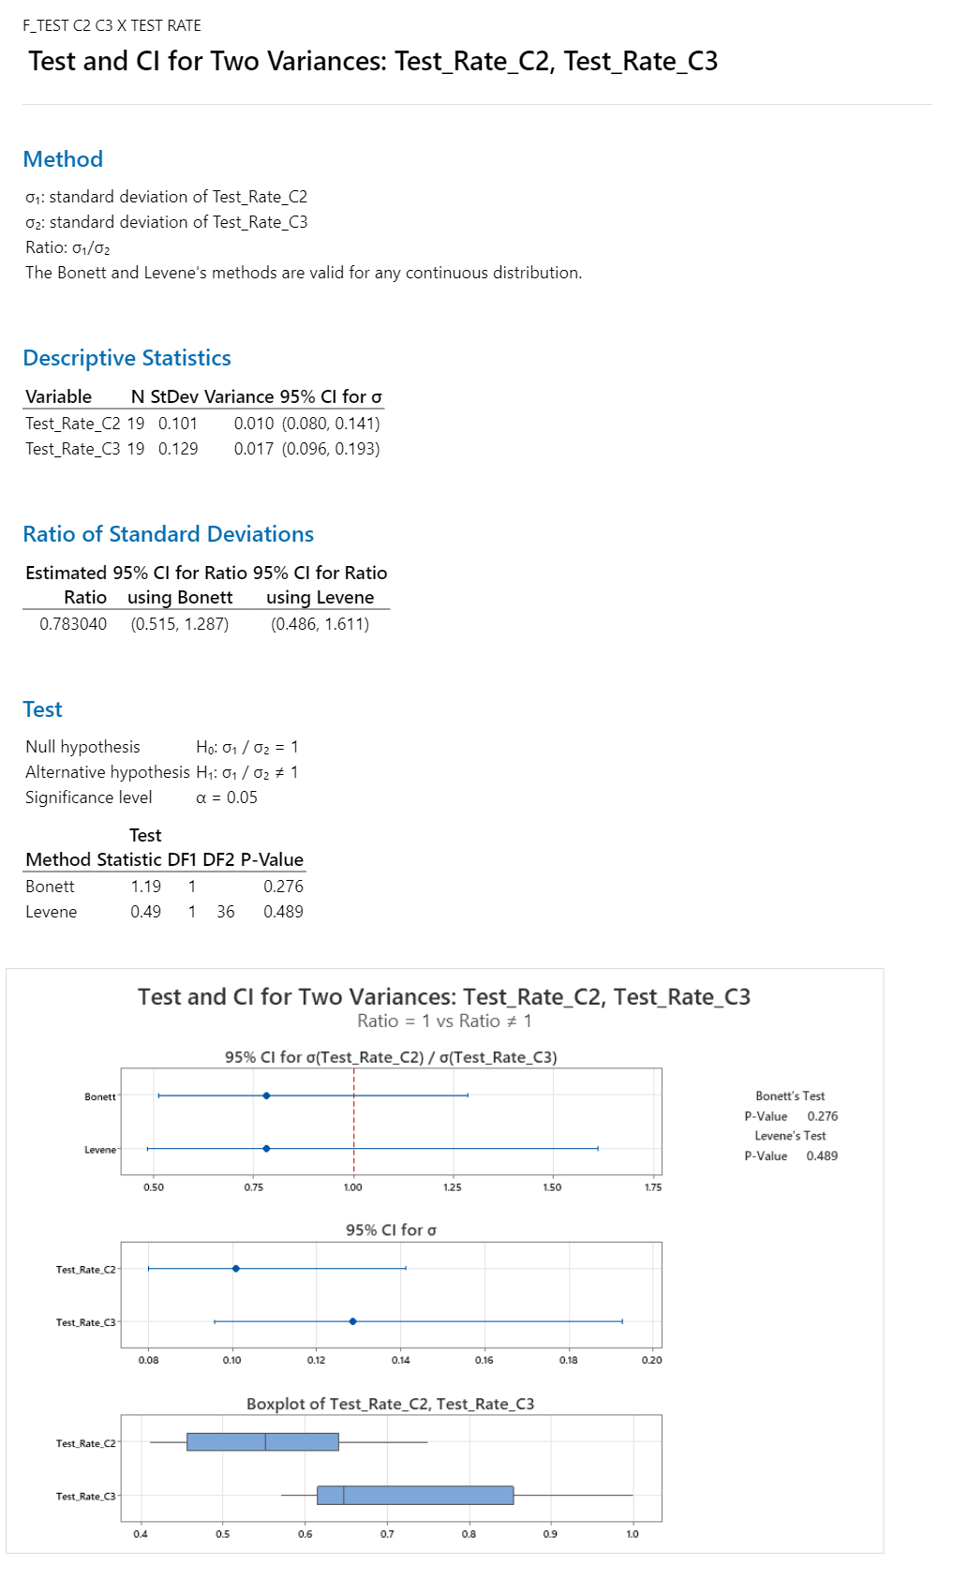
F Test – Test Rate

Slide 88
Results
Productivity Improved
Code Rate Improved
Release planning + UAT support effort decreased
Cycle 2

Slide 89
Cp & Cpk Analysis Cp and Cpk analysis from Minitab and justification

Slide 90
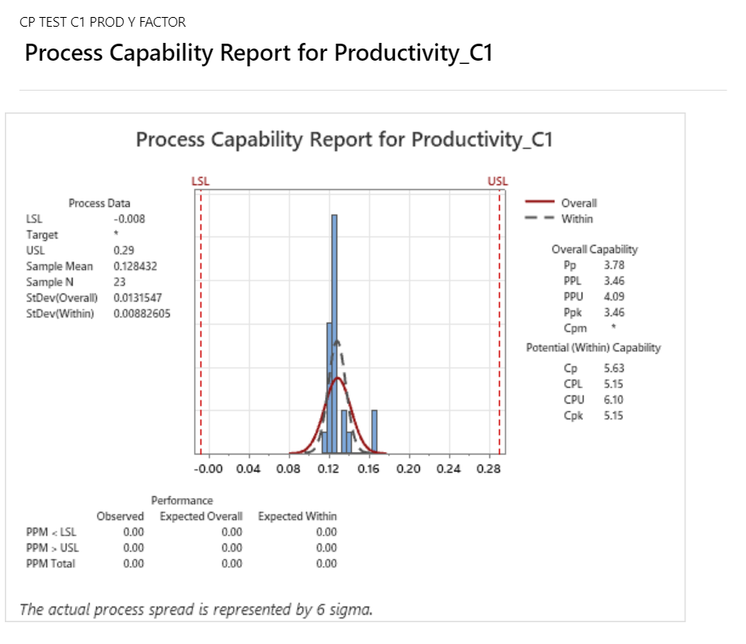
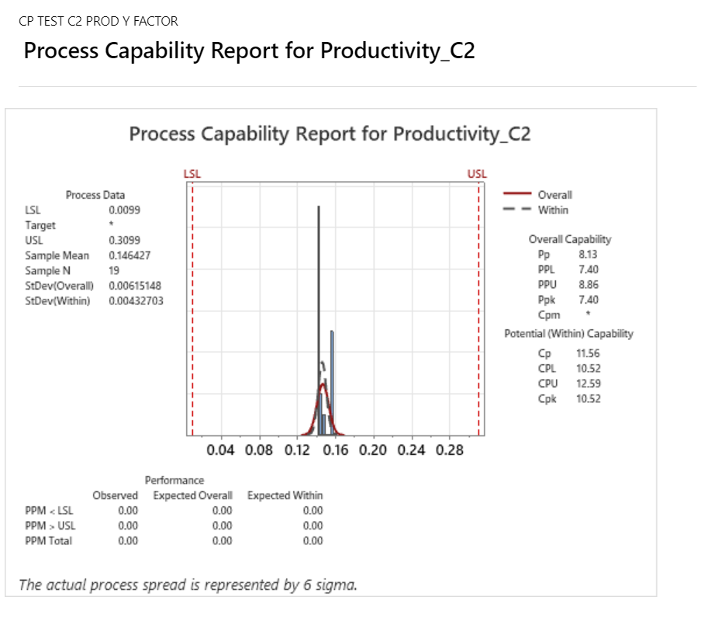
Cp Test – Productivity (cycle 1 & cycle 2 & Cycle 3)

Slide 91
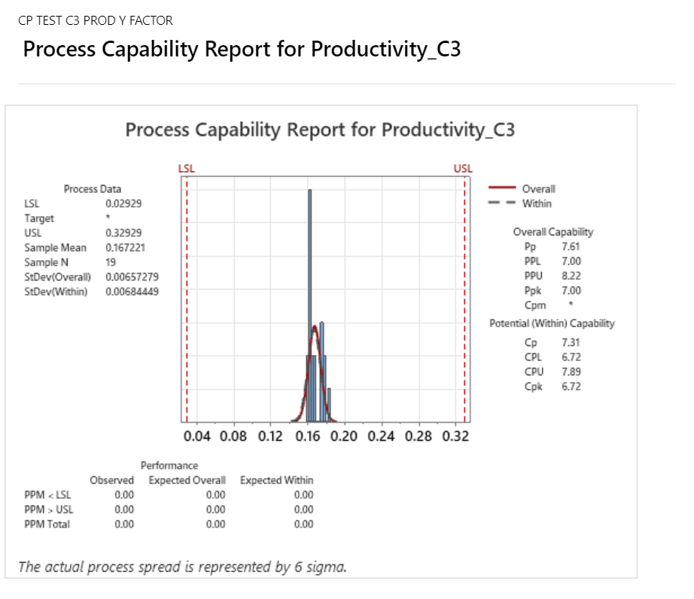
Cp Test – Productivity (cycle 1 & cycle 2 & Cycle 3)

Slide 92


Cp Test – Cycle Time(cycle 1 & cycle 2 & Cycle 3)

Slide 93

Cp Test – Cycle Time(cycle 1 & cycle 2 & Cycle 3)

Slide 94


Cp Cpk Test – DRE(cycle 1 & cycle 2 & Cycle 3)

Slide 95

Cp Cpk Test – DRE(cycle 1 & cycle 2 & Cycle 3)

Slide 96
Results
Capability Model Mean is Normal Distributed
Normal bell curve distribution is spread evenly between LSL and USL
This show model is stable and capable follows Cp > 5 for Y factor of Productivity VALUE.
Cycle 2

